Slide 1
Module 5 PKI Standards and Protocols and Network Fundamentals – Part 1

Slide 2
Module 5 Learning Objectives
On successful completion of this module, students should be able to:
identify and describe standards involved in establishing an interoperable Internet PKI
explain interoperability issues with PKI standards
describe how the common Internet protocols implement the PKI standards
identify and describe the basic network architectures
define the basic network protocols
explain routing and address translation
classify security zones.

Slide 3
Module 5 Learning Resources
Conklin et al. 2016, Principles of Computer Security: CompTIA Security+, 4th edn, Chapters 7 and 9.
The readings from the text for this section are
‘Chapter 7 – Standards and Protocols’ pp. 166-189 and
‘Chapter 9 Network Fundamentals’ pp. 220-251.

Slide 4

PKI Standards and Protocols
Chapter 7
Notes:
None of the still steadily growing Internet commerce would be possible without the use of standards and protocols that provide a common, interoperable environment for exchanging information securely. Due to the wide distribution of Internet users and businesses, the most practical solution to date has been the commercial implementation of public key infrastructures (PKIs).
This chapter examines the standards and protocols involved in secure Internet transactions and e-business using a PKI. Although you may use only a portion of the related standards and protocols on a daily basis, you should understand how they interact to provide the services that are critical for security: confidentiality, integrity, availability, authentication, and nonrepudiation.

Slide 5
Key Terms
Certificate
Certificate Authority (CA)
Certificate Revocation List (CRL)
Internet Security Association and Key Management Protocol (ISAKMP)
IPsec
Pretty Good Privacy (PGP)
Public key infrastructure (PKI)
Secure/Multipurpose Internet Mail Extensions (S/MIME)
Notes:
Certificate – A cryptographically signed object that contains an identity and a public key associated with this identity. The certificate can be used to establish identity, analogous to a notarized written document.
Certificate authority (CA) – An entity responsible for issuing and revoking certificates. CAs are typically not associated with the company requiring the certificate, although they exist for internal company use as well (such as Microsoft). This term also applies to server software that provides these services. The term certificate authority is used interchangeably with certification authority.
Certificate revocation list (CRL) – A digitally signed object that lists all of the current but revoked certificates issued by a given certification authority. This allows users to verify whether a certificate is currently valid even if it has not expired. A CRL is analogous to a list of stolen charge card numbers that allows stores to reject bad credit cards.
Internet Security Association and Key Management Protocol (ISAKMP) – A protocol framework that defines the mechanics of implementing a key exchange protocol and negotiation of a security policy.
IPsec – A protocol used to secure IP packets during transmission across a network. IPsec offers authentication, integrity, and confidentiality services and uses Authentication Headers (AH) and Encapsulating Security Payload (ESP) to accomplish this functionality.
Pretty Good Privacy (PGP) – A popular encryption program that has the ability to encrypt and digitally sign e-mail and files.
Public key infrastructure (PKI) – Infrastructure for binding a public key to a known user through a trusted intermediary, typically a certificate authority.
Secure/Multipurpose Internet Mail Extensions (S/MIME) – An encrypted implementation of the MIME (Multipurpose Internet Mail Extensions) protocol specification.

Slide 6
Key Terms (continued)
Secure Sockets Layer (SSL)
Security Assertion Markup Language (SAML)
Transport Layer Security (TLS)
Wireless Application Protocol (WAP)
Wireless Transport Layer Security (WTLS)
X.509
Notes:
Secure Sockets Layer (SSL) – An encrypting layer between the session and transport layers of the OSI model designed to encrypt above the transport layer, enabling secure sessions between hosts.
Security Assertion Markup Language (SAML) – An XML-based standard for exchanging authentication and authorization data.
Transport Layer Security (TLS) – A newer form of SSL that is now an Internet standard.
Wireless Application Protocol (WAP) – A network access device that facilitates the connection of wireless devices to a network.
Wireless Transport Layer Security (WTLS) – The encryption protocol used on WAP networks.
X.509 – The standard format for digital certificates.

Slide 7
Introduction
There are three categories of PKI standards.
Standards that define the PKI
Standards that define the interface between applications and the underlying PKI
Other standards
Internet public key infrastructure (PKI) relies on three main standards for establishing interoperable PKI services.
PKI X.509 (PKIX), Public Key Cryptography Standards (PKCS), and X.509
Notes:
Standards that define the PKI – These standards define the data and data structures exchanged and the means for managing that data to provide the functions of the PKI (certificate issuance, storage, revocation, registration, and management).
Standards that define the interface between applications and the underlying PKI – These standards use the PKI to establish the services required by applications (S/MIME, SSL, and TLS)T.
Other standards – These standards don’t fit neatly in either of the other two categories. They provide bits and pieces that glue everything together; they not only can address the PKI structure and the methods and protocols for using it, but can also provide an overarching business process environment for PKI implementation (for example, ISO/IEC 27002, Common Criteria, and the Federal Information Processing Standards Publications [FIPS PUBS]).

Slide 8
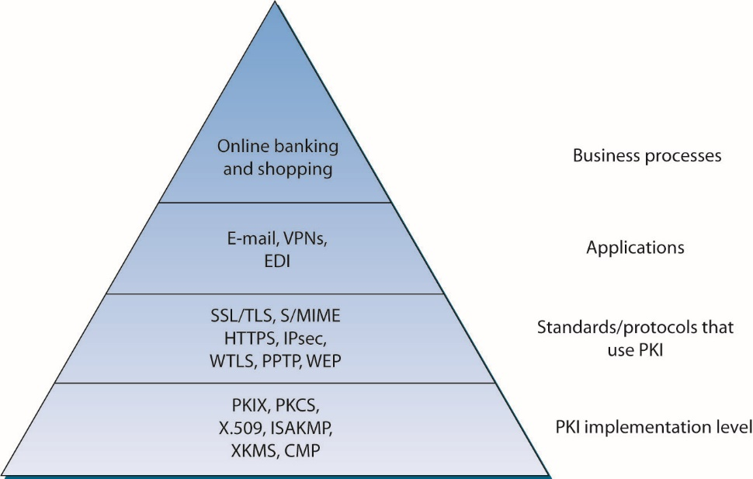
Figure 7.1 Relationships between PKI standards and protocols
Notes:
This diagram shows the relationships between the standards and protocols and conveys the interdependence of the standards and protocols discussed in this chapter.
Other protocols and standards help define the management and operation of the PKI and related services – Internet Security Association and Key Management Protocol (ISAKMP) and XML Key Management Specification (XKMS) are both key management protocols, while Certificate Management Protocol CMP) is used for managing certificates. Certificate Enrollment Protocol (CEP) is an alternative certificate issuance, distribution, and revocation mechanism. Finally, Pretty Good Privacy (PGP) provides an alternative method spanning the protocol and application levels.

Slide 9
PKIX and PKCS
There are two main standards for implementing PKI.
Both are based on the X.509 certificate standard.
PKIX is produced by Internet Engineering Task Force (IETF) and defines standards for interactions and operations for four component types.
User (end-entity), certificate authority (CA), registration authority (RA), repository for certificates, certificate revocation lists (CRLs)
PKCS is produced by RSA security.
Defines lower-level standards for message syntax, cryptographic algorithms, and the like

Slide 10
PKIX and PKCS (continued)
The certificate authority (CA) is responsible for issuing, storing, and revoking certificates—both PKCs and Attribute Certificates (ACs).
The RA is responsible for management activities designated by the CA.
The RA can, in fact, be a component of the CA rather than a separate component.
The certificate revocation list (CRL) is a digitally signed object that lists all of the current but revoked certificates issued by a CA.

Slide 11
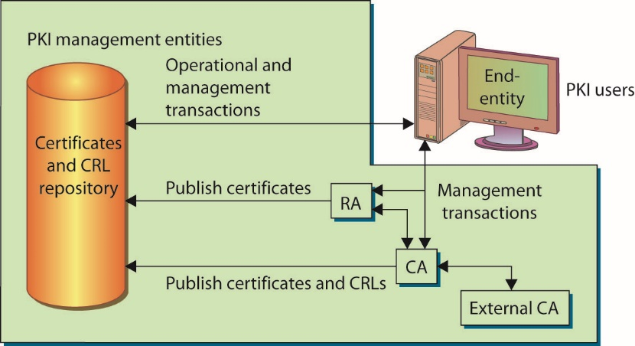
Figure 7.2 The PKIX model
Notes:
PKIX uses the model shown here for representing the components and users of a PKI.
The user, called an end-entity, is not part of the PKI, but end-entities are either users of the PKI certificates, the subject of a certificate (an entity identified by it), or both.
The repository is a system or group of distributed systems that provides certificates and CRLs to the end-entities.

Slide 12
PKIX Standards
Five major areas addressed by PKIX working group
Outlines certificate extensions and content not covered by X.509 v3 and the format of version 2 CRLs.
Provides compatibility standards for sharing certificates and CRLs between CAs and end-entities in different PKIs
Provides certificate management message formats and protocols.
Defines the data structures, management messages, and management functions for PKIs
Notes:
Using X.509 v3, the PKIX working group addresses five major areas:
PKIX outlines certificate extensions and content not covered by X.509 v3 and the format of version 2 CRLs, thus providing compatibility standards for sharing certificates and CRLs between CAs and end-entities in different PKIs. The PKIX profile of the X.509 v3 PKC describes the contents, required extensions, optional extensions, and extensions that need not be implemented. The PKIX profile suggests a range of values for many extensions. In addition, PKIX provides a profile for version 2 CRLs, allowing different PKIs to share revocation information.
PKIX provides certificate management message formats and protocols, defining the data structures, management messages, and management functions for PKIs. The working group also addresses the assumptions and restrictions of their protocols. This standard identifies the protocols necessary to support online interactions between entities in the PKIX model. The management protocols support functions for entity registration, initialization of the certificate (possibly key-pair generation), issuance of the certificate, key-pair update, certificate revocation, cross-certification (between CAs), and key-pair recovery if available.
PKIX outlines certificate policies and certification practices statements (CPSs), establishing the relationship between policies and CPSs. A policy is a set of rules that helps determine the applicability of a certificate to an end-entity. For example, a certificate for handling routine information would probably have a policy on creation, storage, and management of key pairs quite different from a policy for certificates used in financial transactions, due to the sensitivity of the financial information. A CPS explains the practices used by a CA to issue certificates. In other words, the CPS is the method used to get the certificate, while the policy defines some characteristics of the certificate and how it will be handled and used.
PKIX specifies operational protocols, defining the protocols for certificate handling. In particular, protocol definitions are specified for using File Transfer Protocol (FTP) and Hypertext Transfer Protocol (HTTP) to retrieve certificates from repositories. These are the most common protocols for applications to use when retrieving certificates.
PKIX includes time-stamping and data certification and validation services, which are areas of interest to the PKIX working group, and which will probably grow in use over time. A time stamp authority (TSA) certifies that a particular entity existed at a particular time. A Data Validation and Certification Server (DVCS) certifies the validity of signed documents, PKCs, and the possession or existence of data. These capabilities support nonrepudiation requirements and are considered building blocks for a nonrepudiation service.

Slide 13
Five Major Areas Addressed by PKIX Working Group (continued)
Outlines certificate policies and certification practices statements (CPSs), establishing the relationship between policies and CPSs.
Specifies operational protocols, defining the protocols for certificate handling.
Includes time-stamping and data certification and validation services.
Areas of interest to the PKIX working group, and which will probably grow in use over time

Slide 14
PKIX Standards (continued)
Attribute Certificate (AC)
Used to grant permissions using rule-based, role-based, and rank-based access controls.
Used to implement a privilege management infrastructure (PMI).
Notes:
PKCs are the most commonly used certificates, but the PKIX working group has been working on two other types of certificates: Attribute Certificates and Qualified Certificates.
An Attribute Certificate (AC) is used to grant permissions using rule-based, role-based, and rank-based access controls. ACs are used to implement a privilege management infrastructure (PMI). In a PMI, an entity (user, program, system, and so on) is typically identified as a client to a server using a PKC. There are then two possibilities: either the identified client pushes an AC to the server, or the server can query a trusted repository to retrieve the attributes of the client. This situation is modeled in Figure 7.3.

Slide 15
PKIX Standards (continued)
Qualified Certificate (QC)
The QC is based on the term used within the European Commission to identify certificates with specific legislative uses.
PKIX QC profile indicates a certificate used to identify a specific individual with a high level of assurance in a nonrepudiation service.
Notes:
The Qualified Certificate (QC) is based on the term used within the European Commission to identify certificates with specific legislative uses. This concept is generalized in the PKIX QC profile to indicate a certificate used to identify a specific individual (a single human rather than the entity of the PKC) with a high level of assurance in a nonrepudiation service.
There are dozens of IETF Requests for Comment (RFCs) that have been produced by the PKIX working group for each of these five areas. For a complete list of current and pending documents associated with PKIX, see the Internet draft for the PKIX working group roadmap (https://www.ietf.org/archive/id/draft-ietf-pkix-roadmap-09.txt/)

Slide 16
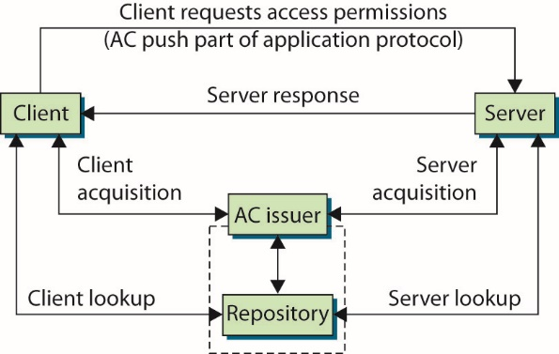
Figure 7.3 The PKIX PMI model
Notes:
In a PMI, an entity (user, program, system, and so on) is typically identified as a client to a server using a PKC. There are then two possibilities: either the identified client pushes an AC to the server, or the server can query a trusted repository to retrieve the attributes of the client.
The client push of the AC has the effect of improving performance, but no independent verification of the client’s permissions is initiated by the server. The alternative is to have the server pull the information from an AC issuer or a repository. This method is preferable from a security standpoint, because the server or server’s domain determines the client’s access rights. The pull method has the added benefit of requiring no changes to the client software.

Slide 17
PKCS
Public Key Cryptography Standards (PKCS) fills gaps in standards that existed in PKI implementing.
PKI developers adopted these standards as a basis for achieving interoperability between different CAs’.
PKCS is composed of a set of 13 active standards.
Two other standards are no longer active.
Standards are referred to as PKCS #1 through PKCS #15.
The standards combine to establish a common base for services required in a PKI.
Notes:
RSA Laboratories created the Public Key Cryptography Standards (PKCS) to fill some of the gaps in the standards that existed in PKI implementation.

Slide 18
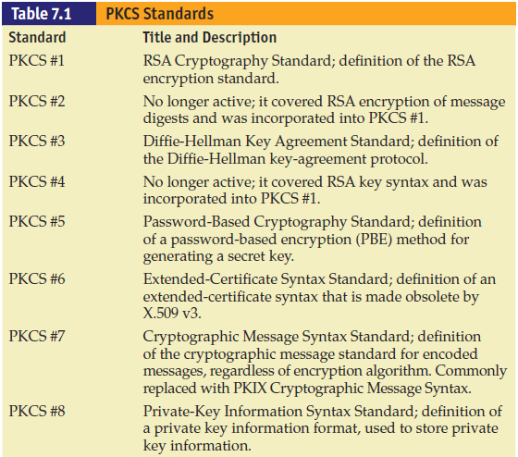
Notes:
Though adopted early in the development of PKIs, some of these standards are being phased out. For example, PKCS #6 is being replaced by X.509 v3 (covered shortly in the “X.509” section) and PKCS #7 and PKCS #10 are being used less, as their PKIX counterparts are being adopted.

Slide 19
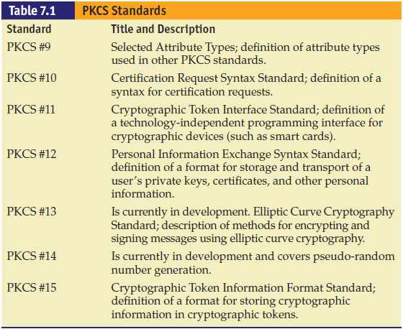
Notes:
Table 7.1 (continued)

Slide 20
Why You Need to Know the PKIX and PKCS Standards
If implementing a private PKI to support secure services within your organization you need to:
Understand what standards are out there
Understand how the decision to use a particular PKI implementation (homegrown or commercial) may lead to incompatibilities with other certificate issuing entities
Consider business-to-business requirements when deciding how to implement a PKI within your organization.
Notes:
If your company is planning to use one of the existing certificate servers to support e-commerce, you may not need to know the specifics of these standards (except perhaps for the CompTIA Security+ exam).

Slide 21
X.509
A certificate is merely a data structure that binds a public key to subjects (unique names, DNS entries, or e-mails) and is used to authenticate that a public key indeed belongs to the subject.
X.509 is the portion of the X.500 standard that addresses the structure of certificates used for authentication.
Version 3 is the current version.
Notes:
In the late 1980s, the X.500 OSI Directory Standard was defined by the International Organization for Standardization (ISO) and the International Telecommunication Union (ITU). It was developed for implementing a network directory system, and part of this directory standard was the concept of authentication of entities within the directory.
Each X.509 certificate version has extended the contents of the certificates to include additional information necessary to use certificates in a PKI. The original ITU X.509 definition was published in 1988, was formerly referred to as CCITT X.509, and is sometimes referred to as ISO/IEC/ITU 9594-8. Version 3 added additional optional extensions for more subject identification information, key attribute information, policy information, and certification path constraints. In addition, version 3 allows additional extensions to be defined in standards or to be defined and registered by organizations or communities.

Slide 22
X.509 (continued)
Certificates are used to encapsulate the information needed to authenticate an entity.
The X.509 specification defines a hierarchical certification structure that relies on a root CA that is self-certifying (meaning it issues its own certificate).
All other certificates can be traced back to such a root through a path.
A CA issues a certificate to a uniquely identifiable entity.
Notes:
We are saved somewhat by the requirement that the CA determines what identifier is unique (the distinguished name), but when certificates and trust are extended between CAs, the unique identification becomes critical.

Slide 23
SSL/TLS
Secure Sockets Layer (SSL) and Transport Layer Security (TLS) provide the most common means of interacting with a PKI and certificates.
They provide secure connections between the client and server for exchanging information.
They provide server authentication (and optionally, client authentication) and information transfer confidentiality.
Notes:
The older, SSL protocol was introduced by Netscape as a means of providing secure connections for web transfers using encryption.

Slide 24
SSL/TLS (continued)
1996: TLS working group was established by the IETF.
Developed a standard transport layer security protocol
Used SSL version 3.0 as its basis and released RFC 2246
Published RFC 2712
TLS is a protocol that ensures privacy between communicating applications and their users on the Internet.
When a server and client communicate, TLS ensures that no third party can eavesdrop or tamper with any message.
Notes:
The TLS working group began with SSL version 3.0 as its basis and released RFC 2246, “The TLS Protocol Version 1.0,” in 1999 as a proposed standard. The working group also published RFC 2712, “Addition of Kerberos Cipher Suites to Transport Layer Security (TLS),” as a proposed standard, and two RFCs on the use of TLS with HTTP.

Slide 25
SSL/TLS (continued)
TLS is composed of two parts.
TLS Record Protocol
It provides connection security by using supported encryption methods.
It can also be used without encryption.
TLS Handshake Protocol
It allows the server and client to authenticate each other and to negotiate a session encryption algorithm and cryptographic keys before data is exchanged.

Slide 26
SSL/TLS (continued)
TLS and SSL are not interoperable.
The TLS protocol contains a mechanism that allows a TLS implementation to back down to SSL 3.0.
Difference between TLS and SSL is the way they perform key expansion and message authentication computations.
TLS has potential vulnerabilities to a man-in-the-middle attack.
A highly skilled and well-placed attacker can force TLS to operate at lower security levels.
Notes:
The TLS Record Protocol is a layered protocol. At each layer, messages may include fields for length, description, and content. The Record Protocol takes messages to be transmitted, fragments the data into manageable blocks, optionally compresses the data, applies a message authentication code (HMAC) to the data, encrypts it, and transmits the result. Received data is decrypted, verified, decompressed, and reassembled, and then delivered to higher-level clients.
TLS still has potential vulnerabilities to a man-in-the-middle attack. A highly skilled and well placed attacker can force TLS to operate at lower security levels. Regardless, through the use of validated and trusted certificates, a secure cipher suite can be selected for the exchange of data. Once established, a TLS session remains active as long as data is being exchanged. If sufficient inactive time has elapsed for the secure connection to time out, it can be reinitiated.

Slide 27
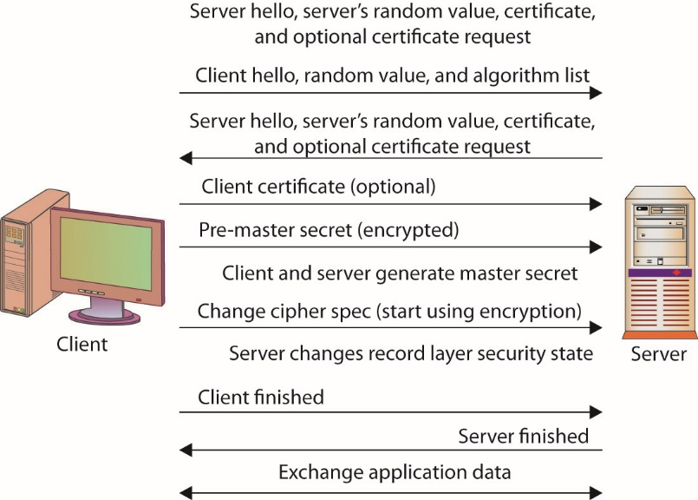
Figure 7.4 TLS Handshake Protocol
Notes:
The TLS Handshake Protocol involves the following steps:
Exchange hello messages to agree on algorithms, exchange random values, and check for session resumption.
Exchange the necessary cryptographic parameters to allow the client and server to agree on a pre-master secret.
Exchange certificates and cryptographic information to allow the client and server to authenticate themselves.
Generate a master secret from the pre-master secret and exchange random values.
Provide security parameters to the record layer.
Allow the client and server to verify that their peer has calculated the same security parameters and that the handshake occurred without tampering by an attacker.

Slide 28
Cipher Suites
The term cipher suite refers to an arranged group of algorithms.
There is a wide range of ciphers, some old and some new, each with its own strengths and weaknesses.
New methods and computational abilities change the viability of ciphers.
Ciphers can become vulnerable to attacks.
Not all ciphers are still strong.
Notes:
In many applications, the use of cryptography occurs as a collection of functions. Different algorithms can be used for authentication, encryption/decryption, digital signatures, and hashing.
There is a wide range of ciphers, some old and some new, each with its own strengths and weaknesses. Over time, new methods and computational abilities change the viability of ciphers. The concept of strong versus weak ciphers is an acknowledgment that, over time, ciphers can become vulnerable to attacks. The application or selection of ciphers should take into consideration that not all ciphers are still strong. When selecting a cipher for use, it is important to make an appropriate choice. For example, if a server offers SSL v3 and TLS, you should choose TLS only, as SSL v3 has been shown to be vulnerable.

Slide 29
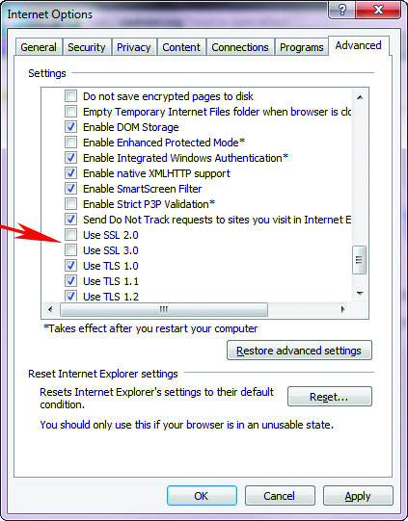
Notes:
Disabling SSL: Because all versions of SSL, including v3, have exploitable vulnerabilities that make the protocol no longer considered secure, users should not rely on it for security. Chrome no longer uses SSL. For Internet Explorer, you need to uncheck the SSL boxes under Internet Options.

Slide 30
Module 5 PKI Standards and Protocols and Network Fundamentals – Part 2

Slide 31
ISAKMP
The Internet Security Association and Key Management Protocol (ISAKMP) provides a method for implementing a key exchange protocol and for negotiating a security policy.
It defines procedures and packet formats to negotiate, establish, modify, and delete security associates.
It does not define implementation-specific protocols, such as the key exchange protocol or hash functions.
Notes:
Because it is a framework, it does not define implementation-specific protocols, such as the key exchange protocol or hash functions.
Examples of ISAKMP are the Internet Key Exchange (IKE) protocol and IPsec, which are used widely throughout the industry.

Slide 32
ISAKMP (continued)
A security association (SA) is a relationship in which two or more entities define how they will communicate securely.
ISAKMP is intended to support SAs at all layers of the network stack.
Can be implemented on the transport layer using TCP or User Datagram Protocol (UDP)
Can be implemented on IP directly

Slide 33
ISAKMP (continued)
Negotiation of an SA between servers occurs in two stages.
First, the entities agree on how to secure negotiation messages (the ISAKMP SA).
Once the entities have secured their negotiation traffic, they then determine the SAs for the protocols used for the remainder of their communications.
Notes:
Once the ISAKMP SA is established, multiple protocol SAs can be established using the single ISAKMP SA. This feature is valuable due to the overhead associated with the two-stage negotiation. SAs are valid for specific periods of time, and once the time expires, the SA must be renegotiated. Many resources are also available for specific implementations of ISAKMP within the IPsec protocol.

Slide 34
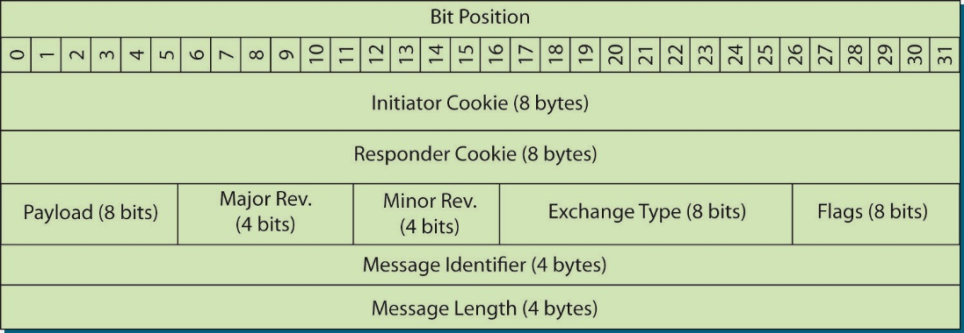
Figure 7.5 ISAKMP header format
Notes:
This figure shows the structure of the ISAKMP header. This header is used during both parts of the ISAKMP negotiation.
The Initiator Cookie is set by the entity requesting the SA, and the responder sets the Responder Cookie. The Payload byte indicates the type of the first payload to be encapsulated. Payload types include security associations, proposals, key transforms, key exchanges, vendor identities, and other things. The Major and Minor Revision fields refer to the major version number and minor version number for the ISAKMP. The Exchange Type helps determine the order of messages and payloads. The Flags bits indicate options for the ISAKMP exchange, including whether the payload is encrypted, whether the initiator and responder have “committed” to the SA, and whether the packet is to be authenticated only (and is not encrypted). The final fields of the ISAKMP header indicate the Message Identifier and a Message Length. Payloads encapsulated within ISAKMP use a generic header, and each payload has its own header format.

Slide 35
CMP
The PKIX Certificate Management Protocol (CMP) is specified in RFC 4210.
The protocol defines the messages and operations required to provide certificate management services within the PKIX model.
It is part of the IETF PKIX effort and provides a framework that works well with other standards (PKCS #7 and PKCS #10).
It provides the following certificate operations:
CA establishment and certification of an end-entity
Notes:
CMP provides for the following certificate operations:
CA establishment, including creation of the initial CRL and export of the public key for the CA
Certification of an end-entity, including the following:
Initial registration and certification of the end-entity (registration, certificate issuance, and placement of the certificate in a repository)
Updates to the key pair for end-entities, required periodically and when a key pair is compromised or keys cannot be recovered
End-entity certificate updates, required when a certificate expires
Periodic CA key-pair updates, similar to end-entity key-pair updates
Cross-certification requests, placed by other CAs
Certificate and CRL publication, performed under the appropriate conditions of certificate issuance and certificate revocation
Key-pair recovery, a service to restore key-pair information for an end-entity; for example, if a certificate password is lost or the certificate file is lost
Revocation requests, supporting requests by authorized entities to revoke a certificate
CMP also defines mechanisms for performing these operations, either online or offline using files, e-mail, tokens, or web operations.

Slide 36
XKMS
Defines services to manage PKI operations within the Extensible Markup Language (XML) environment.
Provides services for handling PKI keys and certificates automatically
Developed by the World Wide Web Consortium (W3C)
Intended to simplify integration of PKIs and management of certificates in applications
Responds to problems of authentication and verification of electronic signatures
Allows certificates to be managed, registered, or revoked

Slide 37
XKMS (continued)
XKMS services reside on a separate server that interacts with an established PKI.
The services are accessible via a simple XML protocol.
Developers can rely on the XKMS services, making it less complex to interface with the PKI.
The services provide for retrieving key information (owner, key value, key issuer, and the like) and key management (such as key registration and revocation).

Slide 38
XKMS (continued)
XKMS functions on three tiers of service:
Tier 0 provides a means of retrieving key information by embedding references to the key within the XML signature.
Tier 1 is called the locate service because it locates the appropriate key information for the client.
Tier 2 is called the validate service.
It is possible to define other tiers of service.
Tiers 3 (an assertion service) and tier 4 (an assertion status service) are mentioned in the defining XKMS specification, but they are not defined.
Notes:
Retrieval operations rely on the XML signature for the necessary information. Three tiers of service are based on the client requests and application requirements.
The primary difference between tier 1 and tier 2 is the level of involvement of the XKMS server. In tier 1, it can serve only as a relay or gateway between the client and the PKI. In tier 2, the XKMS server is actively involved in verifying the relation between the PKI information and the document containing the XML signature.
XKMS also provides services for key registration, key revocation, and key recovery. Authentication for these actions is based on a password or passphrase, which is provided when the keys are registered and when they must be recovered.

Slide 39
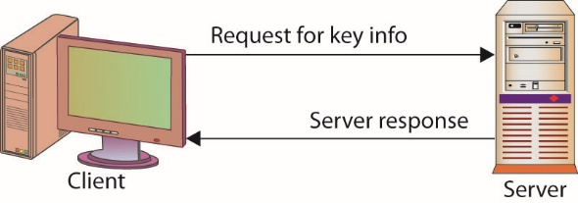
Figure 7.6 XKMS tier 0 retrieval
Notes:
Tier 0 provides a means of retrieving key information by embedding references to the key within the XML signature. The signature contains an element called a retrieval method that indicates ways to resolve the key. In this case, the client sends a request, using the retrieval method, to obtain the desired key information.
For example, if the verification key contains a long chain of X.509 v3 certificates, a retrieval method could be included to avoid sending the certificates with the document. The client would use the retrieval method to obtain the chain of certificates. For tier 0, the server indicated in the retrieval method responds directly to the request for the key, possibly bypassing the XKMS server.

Slide 40
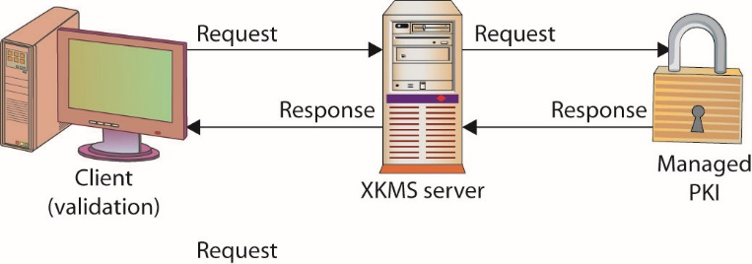
Figure 7.7 XKMS tier 1 locate service
Notes:
With tier 1 operations, the client forwards the key-information portions of the XML signature to the XKMS server, relying on the server to perform the retrieval of the desired key information. The desired information can be local to the XKMS server, or it can reside on an external PKI system. The XKMS server provides no additional validation of the key information, such as checking whether the certificate has been revoked or is still valid. Just as in tier 0, the client performs final validation of the document.

Slide 41
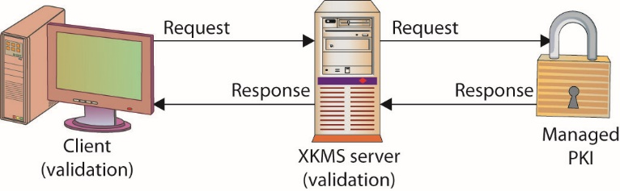
Figure 7.8 XKMS tier 2 validate service
Notes:
Tier 2 is called the validate service and is illustrated in this slide.
In this case, just as in tier 1, the client relies on the XKMS service to retrieve the relevant key information from the external PKI. The XKMS server also performs data validation on a portion of the key information provided by the client for this purpose. This validation verifies the binding of the key information with the data indicated by the key information contained in the XML signature.

Slide 42
S/MIME
The Secure/Multipurpose Internet Mail Extensions (S/MIME) message specification is an extension to the MIME standard that provides a way to send and receive signed and encrypted MIME data.
S/MIME has undergone several revisions with the most recent completed in 2004 by IETF and it requires the use of Advanced Encryption Standard (AES).
Frequent changes have made the S/MIME standard difficult to implement until v3.
Notes:
RSA Security created the first version of the S/MIME standard, using the RSA encryption algorithm and the PKCS series of standards. The second version dates from 1998 but had a number of serious restrictions, including the restriction to 40-bit Data Encryption Standard (DES). The current version of the IETF standard is dated July 2004 and requires the use of Advanced Encryption Standard (AES).
Far from having a stable standard for several years that product manufacturers could have time to gain experience with, there were many changes to the encryption algorithms being used. Just as importantly, and not immediately clear from the IETF documents, the standard places reliance upon more than one other standard for it to function. Key among these is the format of a public key certificate as expressed in the X.509 standard.

Slide 43
IETF S/MIME History
S/MIME v2 specifications lacked many security features required by the Department of Defense (DoD) for use by the military.
S/MIME v3:
Preserved backward compatibility between S/MIME v3 and v2
Mandated a minimum set of cryptographic algorithms
Notes:
A minimum set of cryptographic algorithms was mandated so that different implementations of the new S/MIME v3 set of specifications could be interoperable. This minimum set must be implemented in an application for it to be considered S/MIME-compliant. Applications can implement additional cryptographic algorithms to meet their customers’ needs, but the minimum set must also be present in the applications for interoperability with other S/MIME applications. Thus, users are not forced to use S/MIME-specified algorithms; they can choose their own, but if the application is to be considered S/MIME-compliant, the standard algorithms must also be present.

Slide 44
IETF S/MIME v3 Specifications
Building upon the original work by the IMC-organized group, the IETF has worked hard to enhance the S/MIME v3 specifications.
The ultimate goal is to have the S/MIME v3 specifications receive recognition as an Internet standard.
The current IETF S/MIME v3 set of specifications includes:
Cryptographic Message Syntax (CMS)
S/MIME v3 message specification
S/MIME v3 certificate-handling specification
Enhanced security services (ESS) for S/MIME
Notes:
Building upon the original work by the IMC-organized group, the IETF has worked hard to enhance the S/MIME v3 specifications.
The ultimate goal is to have the S/MIME v3 specifications receive recognition as an Internet standard.

Slide 45
IETF S/MIME v3 Specifications (continued)
The CMS defines a standard syntax for transmitting cryptographic information about contents of a protected message.
The CMS specification was enhanced by the IETF S/MIME working group to include optional security components.
CMS provides backward compatibility with PKCS #7.
Integrity, authentication, and nonrepudiation security features are provided by using digital signatures using the SignedData syntax described by the CMS.
CMS describes the EnvelopedData syntax.
Notes:
CMS also describes what is known as the EnvelopedData syntax to provide confidentiality of the message’s content through the use of encryption. The PKCS #7 specification supports key encryption algorithms, such as RSA. Algorithm independence is promoted through the addition of several fields to the EnvelopedData syntax in CMS, which is the major difference between the PKCS #7 and CMS specifications. The goal was to be able to support specific algorithms such as Diffie-Hellman and the Key Exchange Algorithm (KEA), which is implemented on the Fortezza Crypto Card developed for the DoD. One final significant change to the original specifications is the ability to include X.509 Attribute Certificates in the SignedData and EnvelopedData syntaxes for CMS.

Slide 46
IETF S/MIME v3 Specifications (continued)
CMS triple-encapsulated message
CMS has the ability to nest security envelopes to provide a combination of security features.
Example: A CMS triple encapsulated message can be created in which the original content and associated attributes are signed and encapsulated within the inner SignedData object.
Resulting EnvelopedData object is then also signed and finally encapsulated within a second SignedData object, the outer SignedData object.
Notes:
Usually the inner SignedData object is signed by the original user and the outer SignedData object is signed by another entity, such as a firewall or a mail list agent, providing an additional level of security. This triple encapsulation is not required of every CMS object. All that is required is a single SignedData object created by the user to sign a message or an EnvelopedData object if the user desired to encrypt a message.

Slide 47
PGP
Pretty Good Privacy (PGP) is a popular program for encrypting and decrypting e-mail and files.
It provides the ability to digitally sign a message.
With PGP, the receiver is assured of who sent the message and knows that it was not modified during transmission.
Public-domain versions of PGP have been available for years, as have inexpensive commercial versions.
Notes:
PGP was one of the most widely used programs and was frequently used by both individuals and businesses to ensure data and e-mail privacy. It was developed by Philip R. Zimmermann in 1991 and quickly became a de facto standard for e-mail security. The popularity of PGP lead to the OpenPGP Internet standard, RFC 4880, and open source solutions. GNU Privacy Guard (GPG) is a common alternative to PGP in use today.

Slide 48
How PGP Works
PGP uses a variation of the standard public key encryption process.
An individual (the creator) uses the encryption program to create a pair of keys.
One key, the public key, is given freely to others.
Second key, the private key, is known only by the creator.
Individuals sending a private message to the creator encrypt the message using the creator’s public key.
The algorithm is designed such that only the private key can decrypt the message, so only the creator will be able to decrypt it.
Notes:
Public key or asymmetric encryption, is time consuming. Symmetric encryption uses only a single key and is generally faster. It is because of this that PGP is designed the way it is.
PGP uses a symmetric encryption algorithm to encrypt the message to be sent. It then encrypts the symmetric key used to encrypt this message with the public key of the intended recipient. Both the encrypted key and message are then sent. The receiver’s version of PGP first decrypts the symmetric key with the private key supplied by the recipient and then uses the resulting decrypted key to decrypt the rest of the message.

Slide 49
How PGP Works (continued)
PGP can use two different public key algorithms:
Rivest-ShamirAdleman (RSA) and Diffie-Hellman.
Typically, versions of PGP contain a user interface.
Works with common e-mail programs (Microsoft Outlook).
For others to send you an encrypted message, you need to register your public key.
Use a PGP public key server
Send your public key to all those who want to send you an encrypted message
Post your key to some location for download
Notes:
Where Can You Use PGP?
For many years the U.S. government waged a fight over the exportation of PGP technology, and for many years its exportation was illegal. Today, however, PGP-encrypted e-mail can be exchanged with most users outside the United States, and many versions of PGP are available from numerous international sites. Of course, being able to exchange PGP encrypted e-mail requires that the individuals on both sides of the communication have valid versions of PGP. Interestingly, international versions of PGP are just as secure as domestic versions—a feature that is not true of other encryption products. It should be noted that the freeware versions of PGP are not licensed for commercial purposes.

Slide 50
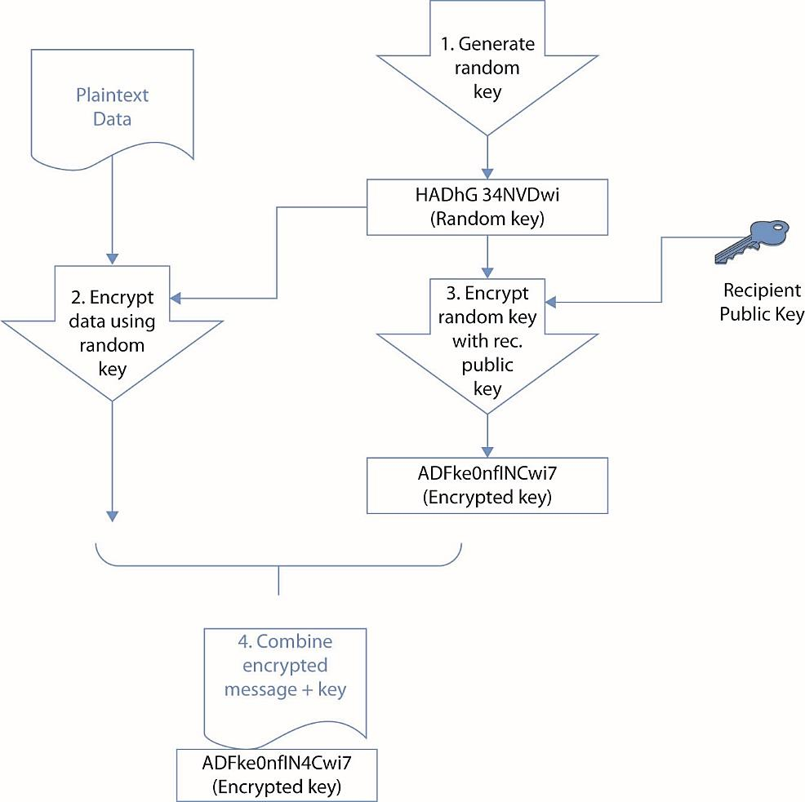
Figure 7.9 How PGP works for encryption
Notes:
PGP can use two different public key algorithms: Rivest-ShamirAdleman (RSA) and Diffie-Hellman.
The RSA version uses the International Data Encryption Algorithm (IDEA) and a short symmetric key to encrypt the message and then uses RSA to encrypt the short IDEA key using the recipient’s public key.
The Diffie-Hellman version uses the Carlisle Adams and Stafford Tavares (CAST) algorithm to encrypt the message and the Diffie-Hellman algorithm to encrypt the CAST key. To decrypt the message, the reverse is performed. The recipient uses their private key to decrypt the IDEA or CAST key, and then uses that decrypted key to decrypt the message.

Slide 51
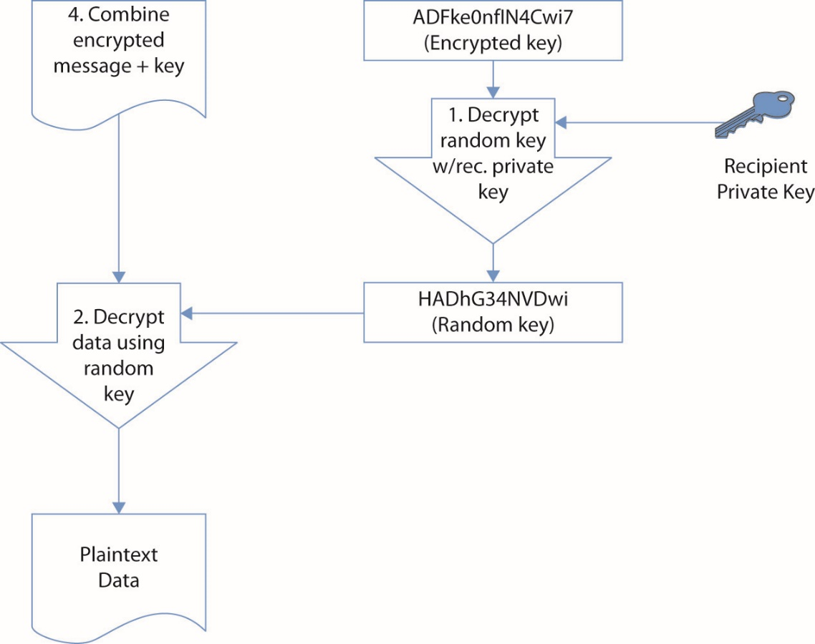
Figure 7.9 How PGP works for encryption (continued)

Slide 52
HTTPS
Most web activity occurs using HTTP.
This protocol is prone to interception.
HTTPS uses either SSL or TLS to secure the communication channel.
HTTPS was originally developed by Netscape Communications and implemented in its browser.
HTTPS has been incorporated into most browsers.
HTTPS uses the standard TCP port 443 for TCP/IP communications.
Only TLS is recommended for HTTPS today.

Slide 53
IPsec
IPsec is a collection of IP security features designed to introduce security at the network or packet-processing layer in network communication.
Optional in IPv4, required in IPv6
IPsec uses two types of security service:
Transport mode can be used to ensure authentication and confidentiality for data alone.
Tunnel mode can be used to ensure authentication and confidentiality for both data and header.
IPsec also provides for payload compression.
Notes:
IPsec is a collection of IP security features designed to introduce security at the network or packet-processing layer in network communication. Other approaches have attempted to incorporate security at higher levels of the TCP/IP suite such as at the level where applications reside. IPsec is designed to provide secure IP communications over the Internet. In essence, IPsec provides a secure version of the IP by introducing authentication and encryption to protect Layer 4 protocols.
IPsec provides two types of security service to ensure authentication and confidentiality for either the data alone (referred to as IPsec transport mode) or for both the data and header (referred to as tunnel mode). See Chapter 11 for more detail on tunneling and IPsec operation. IPsec introduces several new protocols, including the Authentication Header (AH), which basically provides authentication of the sender, and the Encapsulating Security Payload (ESP), which adds encryption of the data to ensure confidentiality.
IPsec also provides for payload compression before encryption using the IP Payload Compression Protocol (IPcomp). Frequently, encryption negatively impacts the ability of compression algorithms to fully compress data for transmission. By providing the ability to compress the data before encryption, IPsec addresses this issue.

Slide 54
CEP
Certificate Enrollment Protocol (CEP) originally designed to support certificate issuance, distribution, and revocation using existing technologies.
Its use has grown in client and CA applications.
The operations supported include CA and RA public key distribution, certificate enrollment, certificate revocation, certificate query, and CRL query.
PKCS #7 and PKCS #10 are used to define message syntax.
It supports access to certificates and CRLs using either the Lightweight Directory Access Protocol (LDAP) or the CEP-defined certificate query.
Notes:
Certificate Enrollment Protocol (CEP) was originally developed by VeriSign for Cisco Systems. It was designed to support certificate issuance, distribution, and revocation using existing technologies.

Slide 55
Other Standards
There are many additional standards associated with information security that are not specifically or solely associated with PKI and/or cryptography.
FIPS
Common Criteria
WTLS
ISO/IEC 27002 (Formerly ISO 17799)
SAML

Slide 56
FIPS
Federal Information Processing Standards Publications (FIPS PUBS or simply FIPS) describe various standards for data communication issues.
FIPS is issued through the National Institute of Standards and Technology (NIST).

Slide 57
FIPS (continued)
Three main categories of FIPS publications include:
Hardware and software standards/guidelines
Data standards/guidelines
Computer security standards/guidelines
Products sold to the U.S. government must comply with relevant FIPS standards.

Slide 58
Common Criteria
Common Criteria for Information Technology Security (Common Criteria or CC)
CC is the result of an effort to develop a joint set of security processes and standards that can be used by the international community.
Major contributors are the governments of the United States, Canada, France, Germany, the Netherlands, and the United Kingdom.
CC provides a listing of laboratories that apply the criteria in testing security products.
Evaluation Assurance Levels – EAL1 through EAL7
Notes:
Products that are evaluated by one of the approved laboratories receive an Evaluation Assurance Level of EAL1 through EAL7 (EAL7 is the highest level), with EAL4, for example, designed for environments requiring a moderate to high level of independently assured security, and EAL1 being designed for environments in which some confidence in the correct operation of the system is required but where the threats to the system are not considered serious. The CC also provides a listing of products by function that have performed at a specific EAL.

Slide 59
SO/IEC 27002 (Formerly ISO 17799)
SO/IEC 27002 is a standard designed for creating and implementing security policies.
SO/IEC 27002 contains material on 12 subject areas.
Risk assessment – determine the impact of risks
Security policy – guidance and policy provided by management
Organization of information security – governance structure to implement security policy
Asset management – inventory and classification of assets

Slide 60
SO/IEC 27002 Subject Areas (continued)
Human resources security – policies and procedures addressing security for employees including hire, change, departure
Physical and environmental security – protection of the computer facilities
Communications and operations management – management of technical security controls in systems and networks
Access control – restriction of access rights to networks, systems, applications, functions, and data

Slide 61
SO/IEC 27002 Subject Areas (continued)
Information systems acquisition, development, and maintenance – building security into applications
Information security incident management – anticipating and responding appropriately to information security breaches
Business continuity management – protecting, maintaining, and recovering business-critical processes and systems
Compliance – ensuring conformance with information security policies, standards, laws, and regulations

Slide 62
SAML
Security Assertion Markup Language (SAML) is a single sign-on capability used for web applications to ensure user identities can be shared and are protected.
SAML defines standards for exchanging authentication and authorization data between security domains.
SAML is increasingly important with cloud-based solutions and with Software-as-a-Service (SaaS) applications.
SAML is an XML-based protocol.
Notes:
SAML is an XML-based protocol that uses security tokens and assertions to pass information about a “principal” (typically an end user) with a SAML authority (an “identity provider” or IdP) and the service provider (SP). The principal requests a service from the SP which then requests and obtains an identity assertion from the IdP. The SP can then grant access or perform the requested service for the principal.

Slide 63
Module 5 PKI Standards and Protocols and Network Fundamentals – Part 3

Slide 64
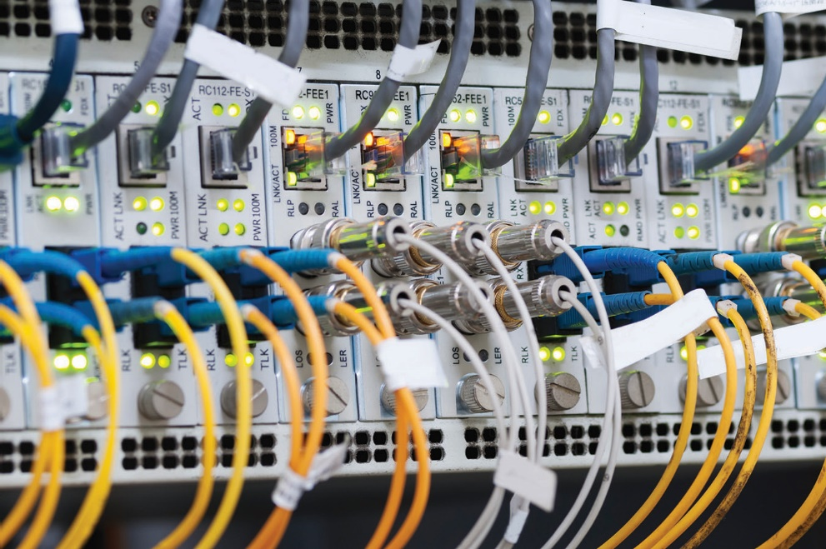
Network Fundamentals
Chapter 9

Slide 65
Key Terms
Address Resolution Protocol (ARP)
Bus topology
Datagram
Denial-of-service (DoS)
Domain Name System (DNS)
DMZ
Dynamic Host Configuration Protocol (DHCP)
Enclave
Ethernet
Extranet
Flat network
Notes:
Address Resolution Protocol (ARP) – A protocol in the TCP/IP suite specification used to map an IP address to a Media Access Control (MAC) address.
Bus topology – A network layout in which a common line (the bus) connects devices.
Datagram – A packet of data that can be transmitted over a packet-switched system in a connectionless mode.
Denial-of-service (DoS) – An attack in which actions are taken to deprive authorized individuals from accessing a system, its resources, the data it stores or processes, or the network to which it is connected.
Domain Name System (DNS) – An attack in which actions are taken to deprive authorized individuals from accessing a system, its resources, the data it stores or processes, or the network to which it is connected.
DMZ – A network segment that exists in a semi-protected zone between the Internet and the inner, secure trusted network.
Dynamic Host Configuration Protocol (DHCP) – An Internet Engineering Task Force (IETF) Internet Protocol (IP) specification for automatically allocating IP addresses and other configuration information based on network adapter addresses. It enables address pooling and allocation and simplifies TCP/IP installation and administration.
Enclave – A section of a network that serves a specific purpose and is isolated by protocols from other parts of a network.
Ethernet – The common name for the IEEE 802.3 standard method of packet communication between two nodes at layer 2.
Extranet – an extension of a selected portion of a company’s intranet to external partners.
Flat network – A network design that avoids packet-looping issues through an architecture that does not have tiers.

Slide 66
Key Terms (continued)
Internet Control Message Protocol (ICMP)
Internet Protocol (IP)
Intranet
Local area network (LAN)
Media Access Control (MAC) address
Network Address Translation (NAT)
Network
Packet
Protocol
Ring topology
Routing
Star topology
Notes:
Internet Control Message Protocol (ICMP) – One of the core protocols of the TCP/IP protocol suite, used for error reporting and status messages.
Internet Protocol (IP) – The network layer protocol used by the Internet for routing packets across a network.
Intranet – a private, internal network that uses common network technologies (such as HTTP, FTP, and so on) to share information and provide
resources to organizational users.
Local area network (LAN) – A grouping of computers in a network structure confined to a limited area and using specific protocols, such as Ethernet for OSI Layer 2 traffic addressing.
Media Access Control (MAC) address – The data link layer address for local network addressing.
Network Address Translation (NAT) – A method of readdressing packets in a network at a gateway point to enable the use of local nonroutable IP addresses over a public network such as the Internet.
Network – A means to connect two or more computers together for the purposes of sharing network information.
Packet – Smaller pieces of data used for transmission resulting from the breaking up of larger data.
Protocol – An agreed-upon format for exchanging or transmitting data between systems, enable computers to communicate.
Ring topology – A network layout in which network components are connected to each other in a closed loop with each device directly connected to two other devices.
Routing – That process of moving packets from one network to another.
Star topology – A network topology where network components are connected to a central point.

Slide 67
Key Terms (continued)
Storage area network (SAN)
Subnetting
Subnet mask
Three-way handshake
Topology
Transmission Control Protocol (TCP)
Trunking
Tunneling
User Datagram Protocol (UDP)
Virtual local area network (VLAN)
Wide area network (WAN)
Notes:
Storage area network (SAN) – A technology-based storage solution consisting of network attached storage.
Subnetting – The creation of a network within a network by manipulating how an IP address is split into network and host portions.
Subnet mask – The information that tells a device how to interpret the network and host portions of an IP address.
Three-way handshake – A means of ensuring information transference through a three-step data exchange. Used to initiate a TCP connection.
Topology – Describes how the network is physically or logically arranged.
Transmission Control Protocol (TCP) – The connection-oriented transport layer protocol for use on the Internet that allows packet-level tracking of a conversation.
Trunking – The process of spanning a single VLAN across multiple switches.
Tunneling – The process of packaging packets so that they can traverse a network in a secure, confidential manner.
User Datagram Protocol (UDP) – A protocol in the TCP/ IP protocol suite for the transport layer that does not sequence packets—it is “fire and forget” in nature.
Virtual local area network (VLAN) – A broadcast domain inside a switched system.
Wide area network (WAN) – A network that spans a large geographic region.

Slide 68
Introduction
By the simplest definition in the data world, a network is a means to connect two or more computers together for the purposes of sharing information.
The term “network” has different meanings depending on the context and usage.
Though data networks vary widely in size and scope, they are generally defined in terms of their architecture, topology, and protocol.
Notes:
Network sizes and shapes vary drastically—from two personal computers connected with a crossover cable or wireless router to the Internet, encircling the globe and linking together untold numbers of individual, distributed systems.

Slide 69
Network Architectures
A local area network (LAN) typically is smaller in terms of size and geographic coverage and consists of two or more connected devices.
Home networks and most small office networks can be classified as LANs.
A wide area network (WAN) tends to be larger, covering more geographic area, and consists of two or more systems in geographically separated areas.
They are connected by leased lines, radio waves, satellite relays, microwaves, or even dial-up connections.
Notes:
Exam Tip: A LAN is a local area network—an office building, home network, and so on. A WAN is a wide area network—a corporate network connecting offices in Dallas, New York, and San Jose, for example.
Every network has an architecture—whether by design or by accident. Defining or describing a specific network’s architecture involves identifying the network’s physical configuration, logical operation, structure, procedures, data formats, protocols, and other components. For the sake of simplicity and categorization, people tend to divide network architectures into two main categories: LANs and WANs.

Slide 70
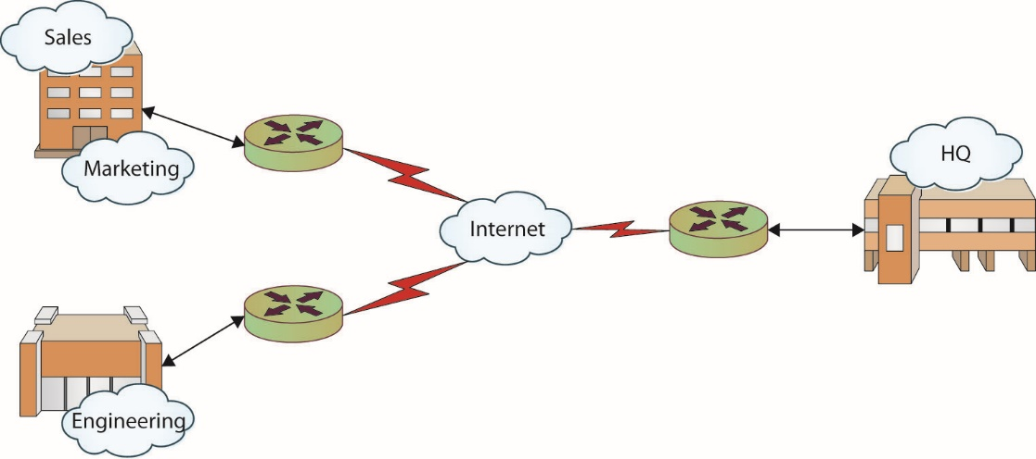
Figure 9.1 Corporate WAN connecting multiple offices
Notes:
Most corporations have multiple LANs within each office location that all connect to a WAN that provides intercompany connectivity.
This figure shows an example of a corporate network. Each office location will typically have one or more LANs, which are connected to the other offices and the company headquarters through a corporate WAN.

Slide 71
Network Architectures (continued)
Specialized network structures are classified by size and use.
Campus area network (CAN)
Intranet
Internet
Metropolitan area network (MAN)
Storage area network (SAN)
Virtual local area network (VLAN)
Client/server
Peer-to-peer
Notes:
Over time, as networks have grown, diversified, and multiplied, the line between LAN and WAN has become blurred. To better describe emerging, specialized network structures, new terms have been coined to classify networks based on size and use:
Campus area network (CAN) – A network connecting any number of buildings in an office or university complex (also referred to as a campus wide area network).
Intranet – A “private” network that is accessible only to authorized users. Many large corporations host an intranet to facilitate information sharing within their organization.
Internet – The “global network” connecting hundreds of millions of systems and users.
Metropolitan area network (MAN) – A network designed for a specific geographic locality such as a town or a city.
Storage area network (SAN) – A high-speed network connecting a variety of storage devices such as tape systems, RAID arrays, optical drives, file servers, and others.
Virtual local area network (VLAN) – A logical network allowing systems on different physical networks to interact as if they were connected to the same physical network.
Client/server – A network in which powerful, dedicated systems called servers provide resources to individual workstations or clients.
Peer-to-peer – A network in which every system is treated as an equal, such as a home network.

Slide 72
Network Topology
Topology refers to how the network is physically or logically arranged.
The main classes of network topologies are:
Star topology – components connected to a central point
Bus topology – components connected to the same cable, often called “the bus” or “the backbone”
Ring topology – components connected to each other in a closed loop with each device directly connected to two other devices
Mixed – uses more than one topology at the same time

Slide 73
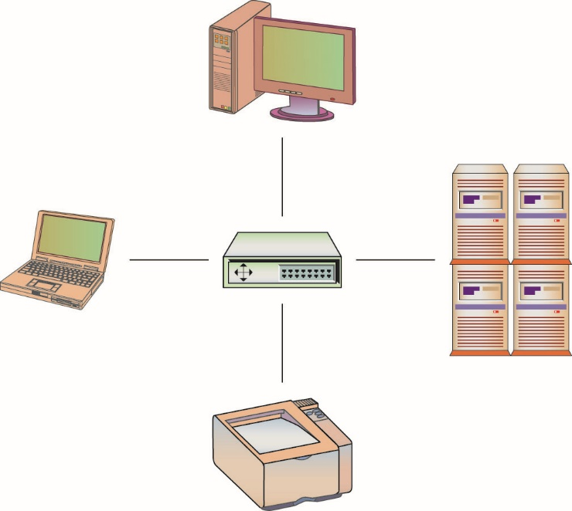
Figure 9.2 Star topology

Slide 74
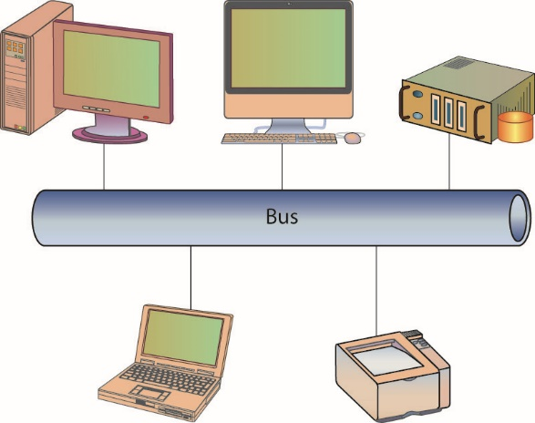
Figure 9.3 Bus topology

Slide 75
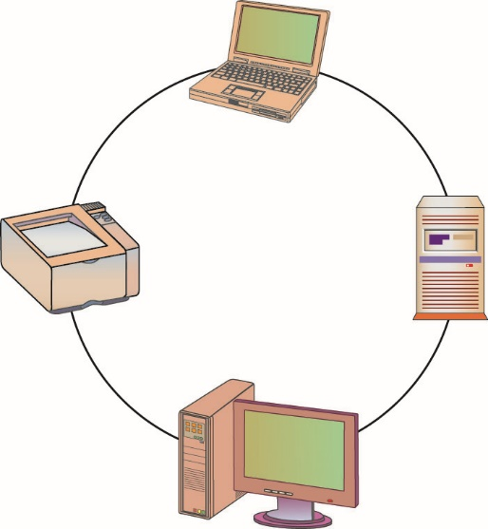
Figure 9.4 Ring topology

Slide 76
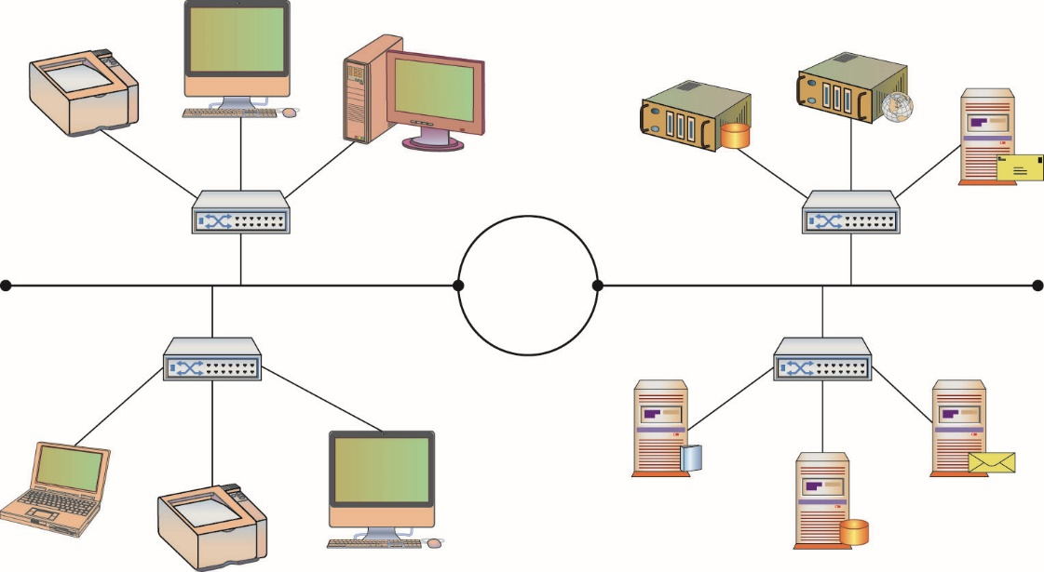
Figure 9.5 Mixed topology
Notes:
Larger networks, such as those inside an office complex, may use more than one topology at the same time. For example, an office complex may have a large ring topology that interconnects all the buildings in the complex. Each building may have a large bus topology to interconnect star topologies located on each floor of the building. This is called a mixed topology or hybrid topology.

Slide 77
Network Protocols
When engineers first started to connect computers together via networks, they quickly realized they needed a commonly accepted method for communicating—a protocol.

Slide 78
Protocols
A protocol is an agreed-upon format for exchanging or transmitting data between systems.
A protocol defines a number of agreed-upon parameters, such as the data compression method, the type of error checking to use, and mechanisms for systems to signal when they have finished either receiving or transmitting data.
Most networks are dominated by Ethernet and Internet Protocol.

Slide 79
Protocols (continued)
AppleTalk
Asynchronous Transfer Mode (ATM)
Ethernet
Fiber Distributed Data Interface (FDDI)
Internet Protocols (IP)
Internetwork Packet Exchange (IPX)
Signaling System 7 (SS7)
Systems Network Architecture (SNA)
Token Ring
Transmission Control Protocol/Internet Protocol (TCP/IP)
X.25A protocol
Notes:
There is a wide variety of protocols, each designed with certain benefits and uses in mind. Some of the more common protocols that have been used in networking are:
AppleTalk – The communications protocol developed by Apple to connect Macintosh computers and printers.
Asynchronous Transfer Mode (ATM) – A protocol based on transferring data in fixed-size packets. The fixed packet sizes help ensure that no single data type monopolizes the available bandwidth.
Ethernet – The LAN protocol developed jointly by Xerox, DEC, and Intel—the most widely implemented LAN standard.
Fiber Distributed Data Interface (FDDI) – The protocol for sending digital data over fiber-optic cabling.
Internet Protocols (IP) – The protocols for managing and transmitting data between packet-switched computer networks, originally developed for the Department of Defense. Most users are familiar with Internet protocols such as e-mail, File Transfer Protocol (FTP), Telnet, and Hypertext Transfer Protocol (HTTP).
Internetwork Packet Exchange (IPX) – The networking protocol created by Novell for use with Novell NetWare operating systems.
Signaling System 7 (SS7) – The telecommunications protocol used between private branch exchanges (PBXs) to handle tasks such as call setup, routing, and teardown.
Systems Network Architecture (SNA) – A set of network protocols developed by IBM, originally used to connect IBM’s mainframe systems.
Token Ring – A LAN protocol developed by IBM that requires systems to possess the network “token” before transmitting data.
Transmission Control Protocol/Internet Protocol (TCP/IP) – The collection of communications protocols used to connect hosts on the Internet. TCP/IP is by far the most commonly used network protocol and is a combination of the TCP and IP protocols.
X.25A protocol – Developed by the Comité Consultatif International Téléphonique et Télégraphique (CCITT) for use in packet-switched networks. The CCITT was a subgroup within the International Telecommunication Union (ITU) before the CCITT was disbanded in 1992.

Slide 80
Protocols (continued)
In most cases, communications protocols were developed around the Open System Interconnection (OSI) model.
OSI defines a framework for implementing protocols and networking components in seven distinct layers.
Control is passed from one layer to another (top-down) before it exits one system and enters another system, where control is passed bottom-up to complete the communications cycle.
Most protocols only loosely follow the OSI model.
Several protocols combine one or more layers.
Notes:
The OSI model, or OSI Reference Model, is an International Organization for Standardization (ISO) standard for worldwide communications that defines a framework for implementing protocols and networking components in seven distinct layers.
The OSI model also provides a certain level of abstraction and isolation for each layer, which only needs to know how to interact with the layer above and below it. The application layer, for example, only needs to know how to communicate with the presentation layer—it does not need to talk directly to the physical layer.

Slide 81
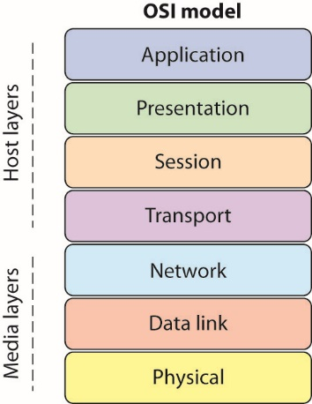
Figure 9.6 The OSI Reference Model
Notes:
This figure shows the different layers of the OSI model.

Slide 82
Packets
Large chunks of data must typically be broken up into smaller, more manageable chunks before they are transmitted from one computer to another.
Advantages of breaking the data up include:
More effective sharing of bandwidth with other systems
Not needing to retransmit the entire dataset if there is a problem in transmission
When data is broken up into smaller pieces for transmission, each of the smaller pieces is typically called a packet.
Notes:
Networks are built to share information and resources, but like other forms of communication, networks and the protocols they use have limits and rules that must be followed for effective communication.
Each protocol has its own definition of a packet—dictating how much data can be carried, what information is stored where, how the packet should be interpreted by another system, and so on.
A standard packet structure is a crucial element in a protocol definition. Without a standard packet structure, systems would not be able to interpret the information coming to them from other systems. Packet-based communication systems have other unique characteristics, such as size, which need to be addressed. This is done via a defined maximum and fragmenting packets that are too big.

Slide 83
Packets (continued)
Maximum Transmission Unit (MTU) is a factor in determining the number of packets into which a message must be broken.
It represents the largest packet that can be carried across a network channel.
The value of the MTU is used by TCP to prevent packet fragmentation at intervening devices.
Packet fragmentation is the splitting of a packet while in transit into two packets so that they fit past an MTU bottleneck.
Notes:
When transmitting packets across a network, there are many intervening protocols and pieces of equipment, each with its own set of limitations.

Slide 84
Packets (continued)
Packet fragmentation is a method of handling large packets.
Internet Protocol has a mechanism for the handling of packets that are larger than allowed across a hop.
Under ICMP v4, a router has two options:
Break the packet into two fragments, sending each separately
Drop the packet and send an ICMP message back to the originator, indicating that the packet is too big
The fragmentation problem can cause excessive levels of packet retransmission.
Notes:
Built into the Internet Protocol is a mechanism for handling of packets that are larger than allowed across a hop. Under ICMP v4, a router has two options when it encounters a packet that is too large for the next hop: break the packet into two fragments, sending each separately, or drop the packet and send an ICMP message back to the originator, indicating that the packet is too big. When a fragmented packet arrives at the receiving host, it must be reunited with the other packet fragments and reassembled. One of the problems with fragmentation is that it can cause excessive levels of packet retransmission as TCP must retransmit an entire packet for the loss of a single fragment. In IPv6, to avoid fragmentation, hosts are required to determine the minimal path MTU before transmission of packets to avoid fragmentation en route. Any fragmentation requirements in IPv6 are resolved at the origin, and if fragmentation is required, it occurs before sending.

Slide 85
Packet Fragmentation (continued)
Steps are taken to avoid fragmentation in IPv6.
Hosts are required to determine the minimal path MTU before transmission of packets to avoid fragmentation en route.
Any fragmentation requirements in IPv6 are resolved at the origin, and if fragmentation is required, it occurs before sending.
IP fragmentation can be exploited in a variety of ways to bypass security measures.
Notes:
IP fragmentation can be exploited in a variety of ways to bypass security measures. Packets can be purposefully constructed to split exploit code into multiple fragments to avoid IDS detection. Because the reassembly of fragments is dependent upon data in the fragments, it is possible to manipulate the fragments to result in datagrams that exceed the 64KB limit, resulting in denial of service.

Slide 86
Internet Protocol
The Internet Protocol is not a single protocol but a suite of protocols.
The two versions of the protocol in use are v4 and v6.
There are differences between the two versions.
One difference is the replacement of the Internet Group Management Protocol (IGMP) with the Internet Control Message Protocol (ICMP) and Multicast Listener Discovery (MLD) in IPv6

Slide 87
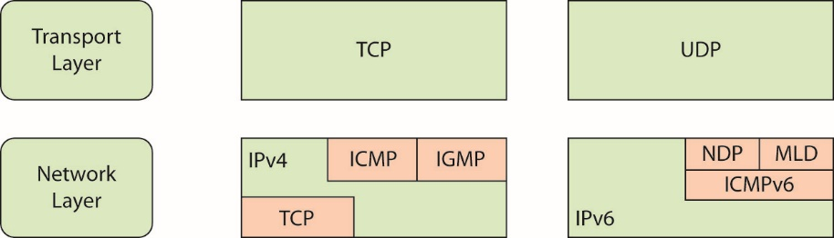
Figure 9.7 Internet Protocol suite components
Notes:
This figure shows the relationship between some of the IP suite and the OSI model.

Slide 88
IP Packets
An IP packet, often called a datagram, has two main sections:
Header – contains all of the information needed to describe the packet.
Data section – sometimes called the payload

Slide 89
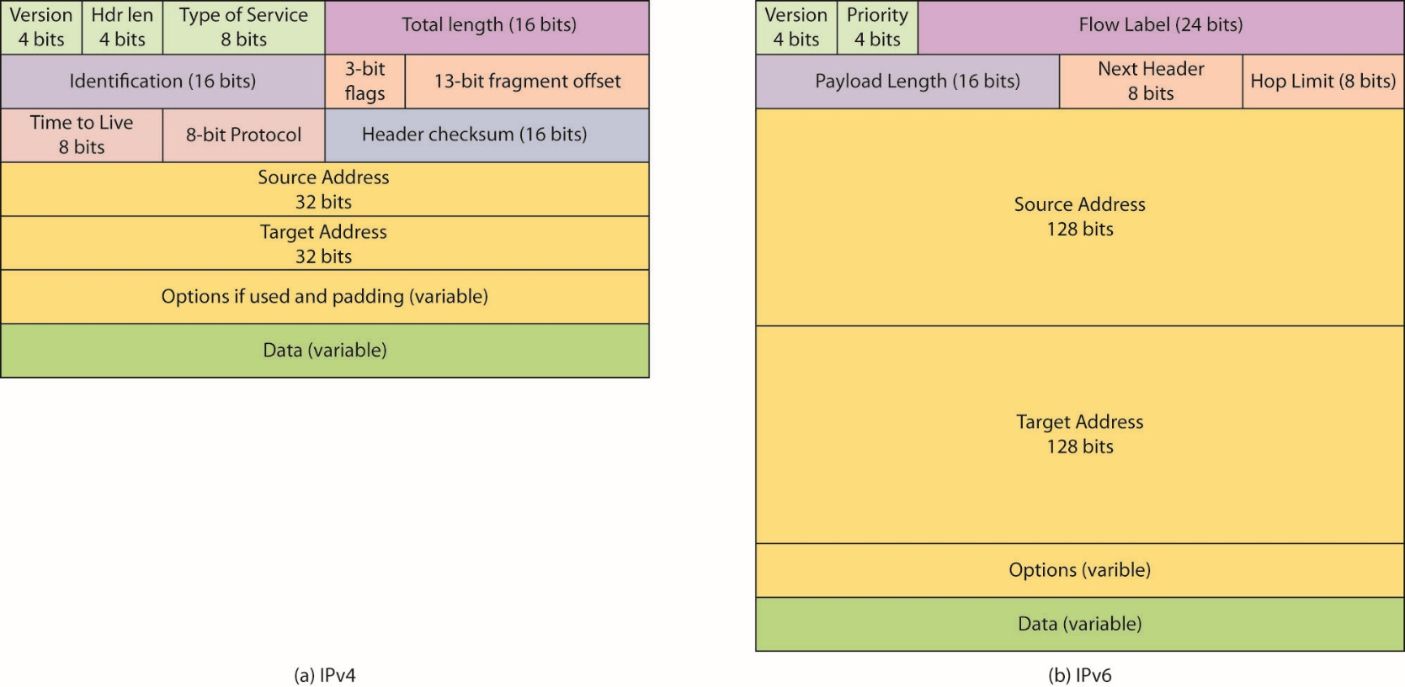
Figure 9.8 Logical layout of an IP packet, (a) IPv4 (b) IPv6
Notes:
In IPv6, the source and destination addresses take up much greater room, and for equipment and packet handling reasons, most of the informational options have been moved to the optional area after the addresses. This series of optional extension headers allows the efficient use of the header in processing the routing information during packet routing operations. One of the most common options is the IPsec extension, which is used to establish IPsec connections. IPsec uses encryption to provide a variety of protections to packets.

Slide 90
TCP vs. UDP
Two protocols required for Internet’s existence
Transmission Control Protocol (TCP) and User Datagram Protocol (UDP)
Both protocols run on top of the IP network protocol.
As separate protocols, they each have their own packet definitions, capabilities, and advantages.
Most important difference between TCP and UDP is the concept of “guaranteed” reliability and delivery.
Notes:
Exam Tip: TCP is a “connection-oriented” protocol and offers reliability and guaranteed delivery of packets. UDP is a “connectionless” protocol with no guarantees of delivery.

Slide 91
TCP vs. UDP (continued)
UDP is known as a “connectionless” protocol.
It has very few error recovery services and no guarantee of packet delivery.
Sender has no idea whether the packets were successfully received or whether they were received in order.
UDP is considered to be an unreliable protocol.
UDP is good for time synchronization requests, name lookups, and streaming audio.
It is a fairly “efficient” protocol in terms of content delivery versus overhead.
Notes:
With UDP, more time and space is dedicated to content (data) delivery than with other protocols such as TCP. This makes UDP a good candidate for streaming protocols, as more of the available bandwidth and resources are used for data delivery than with other protocols.

Slide 92
TCP vs. UDP (continued)
TCP is a “connection-oriented” protocol specifically designed to provide a reliable connection between two hosts exchanging data.
TCP is designed to ensure packets processed in the same order in which they were sent.
Packet sequence number shows where each packet fits into the overall conversation.
TCP requires systems to follow a specific pattern when establishing communications called the three-way handshake.
Notes:
As part of TCP, each packet has a sequence number to show where that packet fits into the overall conversation. With the sequence numbers, packets can arrive in any order and at different times and the receiving system will still know the correct order for processing them. The sequence numbers also let the receiving system know if packets are missing—receiving packets 1, 2, 4, and 7 tells us that packets 3, 5, and 6 are missing and needed as part of this conversation. The receiving system can then request retransmission of packets from the sender to fill in any gaps.
The “guaranteed and reliable” aspect of TCP makes it very popular for many network applications and services such as HTTP, FTP, and Telnet.

Slide 93
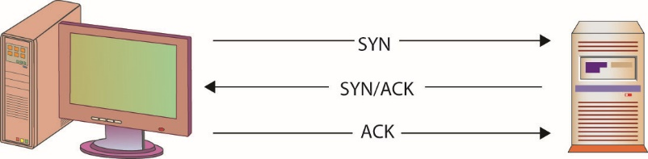
Figure 9.9 TCP’s three-way handshake
Notes:
As part of the connection, TCP requires that systems follow a specific pattern when establishing communications. This pattern, often called the three-way handshake, is a sequence of very specific steps:
The originating host (usually called the client) sends a SYN (synchronize) packet to the destination host (usually called the server). The SYN packet tells the server what port the client wants to connect to and the initial packet sequence number of the client.
The server sends a SYN/ACK packet back to the client. This SYN/ACK (synchronize/acknowledge) tells the client “I received your request” and also contains the server’s initial packet sequence number.
The client responds to the server with an ACK packet to complete the connection establishment process.
Note: Think of the three-way handshake as being similar to a phone call. You place a call to your friend—that’s the SYN. Your friend answers the phone and says “hello”—that’s the SYN/ACK. Then you say “Hi, it’s me”—that’s the ACK. Your connection is established and you can start your conversation.

Slide 94
ICMP
Internet Control Message Protocol (ICMP) is probably the third most commonly used protocol.
ICMP is a control and information protocol.
It is used by network devices to determine such things as a remote network’s availability, the length of time to reach a remote network, and the best route for packets to take when traveling to that remote network.
ICMP can also be used to handle traffic flow.
ICMP is a connectionless protocol designed to carry small messages quickly with minimal overhead or impact to bandwidth.
Notes:
During the early development of large networks, it was quickly discovered that there needed to be some mechanism for managing the overall infrastructure—handling connection status, traffic flow, availability, and errors. This mechanism is ICMP.
ICMP can also be used to handle the flow of traffic, telling other network devices to “slow down” transmission speeds if packets are coming in too fast. ICMP, like UDP, is a connectionless protocol. ICMP was designed to carry small messages quickly with minimal overhead or impact to bandwidth.

Slide 95
ICMP (continued)
ICMP has been greatly abused by attackers over the last few years.
Attackers execute denial-of-service (DoS) attacks.
Because ICMP packets are very small and connectionless, thousands and thousands of ICMP packets can be generated by a single system in a very short period of time.
Attackers have developed methods to trick many systems into generating thousands of ICMP packets with a common destination—the attacker’s target.
Notes:
Attackers have developed methods to trick many systems into generating thousands of ICMP packets with a common destination—the attacker’s target. This creates a literal flood of traffic that the target, and in most cases the network the target sits on, is incapable of dealing with. The ICMP flood drowns out any other legitimate traffic and prevents the target from accomplishing its normal duties—denying access to the service the target normally provides. This has led to many organizations blocking all external ICMP traffic at the perimeter of their organization.

Slide 96
IPv4 vs. IPv6
The most common version of IP in use is IPv4.
The release of IPv6, spurred by the depletion of the IPv4 address space, has begun a typical logarithmic adoption curve.
IPv6 has many similarities to the previous version.
IPv6 has significant new enhancements, many of which have significant security implications.

Slide 97
IPv4 vs. IPv6 (continued)
IPv6 features an expanded address space.
Address space expanded to 128 bits.
IPv6 has over 1500 addresses per square meter of the entire earth’s surface.
Scanning all addresses for responses will take a significantly long time.
One millisecond scan in IPv4 equates to a 2.5 billion year scan in IPv6.
The IPv6 addressing protocol designed to allow for a hierarchal division of the address space into several layers of subnets.
Notes:
The expansion of the address space from 32 bits to 128 bits is a significant change. Where IPv4 did not have enough addresses for each person on earth, IPv6 has over 1500 addresses per square meter of the entire earth’s surface. This has one immediate implication: where you could use a scanner to search all addresses for responses in IPv4, doing the same in IPv6 will take significantly longer. A one millisecond scan in IPv4 equates to a 2.5 billion year scan in IPv6. In theory, the 128 bits of IPv6 address space will express 3.4 × 1038 possible nodes. The IPv6 addressing protocol has been designed to allow for a hierarchal division of the address space into several layers of subnets, to assist in the maintaining of both efficient and logical address allocations. One example is the embedding of the IPv4 address space in the IPv6 space. This also has an intentional effect of simplifying the backbone routing infrastructures by reducing the routing table size.

Slide 98
IPv4 vs. IPv6 (continued)
IPv6 introduces the Network Discovery (NDP) protocol.
NDP is useful for auto-configuration of networks.
NDP can enable a variety of interception and interruption threat modes.
A malevolent router can attach itself to a network and reroute or interrupt traffic flows.

Slide 99
Benefits of IPv6
IPv6 offers several benefits.
IPv6 is more secure because it has many security features built into the base protocol series.
IPv6 has a simplified packet header and new addressing scheme.
This can lead to more efficient routing through smaller routing tables and faster packet processing.
IPv6 was designed to incorporate multicasting flows natively which allows bandwidth-intensive multimedia streams to be sent simultaneously to multiple destinations.

Slide 100
Benefits of IPv6 (continued)
IPv6 has a host of new services, from auto-configuration to mobile device addressing, and service enhancements to improve the robustness of QoS and VoIP functions.
The security model of IPv6 is baked into the protocol.
Notes:
The use of IPsec will change the way security functions are performed across the enterprise. Old IPv4 methods, such as NAT and packet inspection methods of IDS, will need to be adjusted to the new model. Security appliances will have to adapt to the new protocol and its enhanced nature.

Slide 101
Benefits of IPv6 (continued)
IPv6 is designed to be secure from sender to receiver, with IPsec available natively across the protocol.
This will significantly improve communication level security, but it has also drawn a lot of attention.
The use of IPsec will change the way security functions are performed across the enterprise.
Notes:
The use of IPsec will change the way security functions are performed across the enterprise. Old IPv4 methods, such as NAT and packet inspection methods of IDS, will need to be adjusted to the new model. Security appliances will have to adapt to the new protocol and its enhanced nature.

Slide 102
Packet Delivery
Packet delivery can be divided into two sections.
Local packet delivery applies to packets being sent out on a local network.
Ethernet is common for local packet delivery
Remote packet delivery applies to packets being delivered to a remote system, such as across the Internet.
IP works for remote delivery
Notes:
Protocols are designed to help information get from one place to another, but in order to deliver a packet we have to know where it is going.

Slide 103
Packet Delivery (continued)
Packets may follow a local delivery–remote delivery–local delivery pattern before reaching the intended destination.
The biggest difference in local versus remote delivery is the manner in which packets are addressed.

Slide 104
Ethernet
Ethernet is the most widely implemented Layer 2 protocol.
Ethernet is standardized under IEEE 802.3.
Ethernet works by forwarding packets on a hop-to-hop basis using MAC addresses.
It can have numerous security implications.
Layer 2 addresses can be poisoned; spanning tree algorithms can be attacked; VLANs can be hopped.
It has many elements that make it useful from a networking point of view, but these elements can also act against security concerns.
Notes:
Because of its near ubiquity, Ethernet is a common attack vector.
It has many elements that make it useful from a networking point of view, such as its broadcast nature and its ability to run over a wide range of media. But these can also act against security concerns. Wireless connections are frequently considered to be weak from a security point of view, but so should Ethernet, for unless you own the network, you should consider the network to be at risk.

Slide 105
Local Packet Delivery
Packets delivered on a network, such as an office LAN, are usually sent using the destination system’s hardware address, or Media Access Control (MAC) address.
In order for a system to send data to another system on the network, it must first find out the destination system’s MAC address.
To find another system’s MAC address, the Address Resolution Protocol (ARP) is used.
Notes:
Each network card or network device is supposed to have a unique hardware address so that it can be specifically addressed for network traffic. MAC addresses are assigned to a device or network card by the manufacturer, and each manufacturer is assigned a specific block of MAC addresses to prevent two devices from sharing the same MAC address. MAC addresses are usually expressed as six pairs of hexadecimal digits, such as 00:07:e9:7c:c8:aa. In order for a system to send data to another system on the network, it must first find out the destination system’s MAC address.
Maintaining a list of every local system’s MAC address is both costly and time consuming, and although a system may store MAC addresses temporarily for convenience, in many cases the sender must find the destination MAC address before sending any packets. To find another system’s MAC address, the Address Resolution Protocol (ARP) is used. Essentially, this is the computer’s way of finding out “who owns the blue convertible with license number 123JAK.” In most cases, systems know the IP address they wish to send to, but not the MAC address. Using an ARP request, the sending system will send out a query: Who is 10.1.1.140? This broadcast query is examined by every system on the local network, but only the system whose IP address is 10.1.1.140 will respond. That system will send back a response that says “I’m 10.1.1.140 and my MAC address is 00:07:e9:7c:c8:aa.” The sending system will then format the packet for delivery and drop it on the network media, stamped with the MAC address of the destination workstation.

Slide 106
Local Packet Delivery (continued)
ARP is open to attacks.
ARP can be a vector employed to achieve a man-in-the-middle attack.
ARP poisoning creates false entries in an ARP cache.
The attacker can inject himself into the middle of a communication; hijack a session; sniff traffic to obtain passwords or other sensitive items; or block the flow of data, creating a denial of service.
Higher-level packet protections such as IPsec can be employed so that the packets are unreadable by interlopers.
Notes:
There are many specific ways to create false entries in a machine’s ARP cache, but the effect is the same: communications will be routed to an attacker. This type of attack is called ARP poisoning. The attacker can use this method to inject himself into the middle of a communication, hijack a session, sniff traffic to obtain passwords or other sensitive items, or block the flow of data, creating a denial of service.
Although ARP is not secure, all is not lost with many ARP-based attacks. Higher-level packet protections such as IPsec can be employed so that the packets are unreadable by interlopers. This is one of the security gains associated with IPv6, because when security is employed at the Ipsec level, packets are protected below the IP level, making Layer 2 attacks less successful.

Slide 107
Remote Packet Delivery
Packet delivery to a distant system is usually accomplished using Internet Protocol (IP) addresses.
In order to send a packet to a specific system on the other side of the world, you have to know the remote system’s IP address.
Storing large numbers of IP addresses on every PC is far too costly, and most humans are not good at remembering collections of numbers.
However, humans are good at remembering names, so the Domain Name System (DNS) protocol was created.
Notes:
IP addresses are 32-bit numbers that usually are expressed as a group of four numbers (such as 10.1.1.132).

Slide 108
Remote Packet Delivery (continued)
DNS translates names into IP addresses.
When you enter the name of a web site in the location bar of a web browser and press ENTER, the computer has to figure out what IP address belongs to that name.
Before sending a packet, your system will first determine if the destination IP address is on a local or remote network.
Network gateways, usually called routers, are devices that are used to interconnect networks and move packets from one network to another.
Notes:
Note: The Domain Name System is critical to the operation of the Internet—if your computer can’t translate www.espn.com into 68.71.212.159, then your web browser won’t be able to access the latest scores. (As DNS is a dynamic system, the IP address may change for www.espn.com; you can check with the tracert command.)

Slide 109
Remote Packet Delivery (continued)
The process of moving packets from one network to another is called routing.
Routing is critical to the flow of information across the Internet.
Routers use forwarding tables to determine where a packet should go.
When a packet reaches a router, the router looks at the destination address to determine where to send the packet.
Notes:
Before sending the packet, your system will first determine if the destination IP address is on a local or remote network. In most cases, it will be on a remote network and your system will not know how to reach that remote network. Again, it would not be practical for your system to know how to directly reach every other system on the Internet, so your system will forward the packet to a network gateway. Network gateways, usually called routers, are devices that are used to interconnect networks and move packets from one network to another.
That process of moving packets from one network to another is called routing and is critical to the flow of information across the Internet. To accomplish this task, routers use forwarding tables to determine where a packet should go. When a packet reaches a router, the router looks at the destination address to determine where to send the packet.
If the router’s forwarding tables indicate where the packet should go, the router sends the packet out along the appropriate route. If the router does not know where the destination network is, it forwards the packet to its defined gateway, which repeats the same process. Eventually, after traversing various networks and being passed through various routers, your packet arrives at the router serving the network with the web site you are trying to reach. This router determines the appropriate MAC address of the destination system and forwards the packet accordingly.

Slide 110
Remote Packet Delivery (continued)
DNSSEC is an extension of the original DNS specification, making it trustworthy.
Lack of trust in DNS and the inability to authenticate DNS messages drove the need for and creation of DNSSEC.
DNSSEC specification was formally published in 2005, but system-wide adoption has been slow.
One of the reasons for slow adoption is complexity.
The Internet today, and its use for all kinds of critical communications, needs a trustworthy addressing mechanism.

Slide 111
Module 5 PKI Standards and Protocols and Network Fundamentals – Part 4

Slide 112
IP Addresses and Subnetting
IP address are 32-bit numbers represented as four groups of 8 bits each (called octets).
Some are used for the network portion of the address (the network ID), and some are used for the host portion of the address (the host ID).
Subnetting is the process that is used to divide those 32 bits in an IP address and tell you how many of the 32 bits are being used for the network ID and how many are being used for the host ID.
Notes:
IPv4 addresses are 32-bit numbers. You will usually see IP addresses expressed as four sets of decimal numbers in dotted-decimal notation, 10.120.102.15 for example.
As you can guess, where and how you divide the 32 bits determines how many networks and how many host addresses you may have. To interpret the 32-bit space correctly, we must use a subnet mask, which tells us exactly how much of the space is the network portion and how much is the host portion.

Slide 113
IP Addresses and Subnetting (continued)
To interpret the 32-bit space correctly, we must use a subnet mask, which tells us exactly how much of the space is the network portion and how much is the host portion.
Let’s look at an example using the IP address 10.10.10.101 with a subnet mask of 255.255.255.0.
First you must convert the address and subnet mask to their binary representations:
Subnet Mask: 11111111.11111111.11111111.00000000
IP Address: 00001010.00001010.00001010.01100101
Notes:
Let’s look at an example using the IP address 10.10.10.101 with a subnet mask of 255.255.255.0. First you must convert the address and subnet mask to their binary representations:
Subnet Mask: 11111111.11111111.11111111.00000000
IP Address: 00001010.00001010.00001010.01100101

Slide 114
IP Addresses and Subnetting (continued)
Then, you perform a bitwise AND operation to get the network address.
Our network address is:
00001010.00001010.00001010.00000000
In decimal this is 10.10.10.0: the network ID of our IP network address.
In our example, the network portion of the address is 10.10.10 and the host portion is 101.
Notes:
Then, you perform a bitwise AND operation to get the network address. The bitwise AND operation examines each set of matching bits from the binary representation of the subnet mask and the binary representation of the IP address. For each set where both the mask and address bits are 1, the result of the AND operation is a 1. Otherwise, if either bit is a 0, the result is a 0.
So, for our example we get Network Address: 00001010.00001010.00001010.00000000 which in decimal is 10.10.10.0, the network ID of our IP network address (translate the binary representation to decimal). The network ID and subnet mask together tell us that the first three octets of our address are network-related (10.10.10.), which means that the last octet of our address is the host portion (101 in this case). In our example, the network portion of the address is 10.10.10 and the host portion is 101.
Another shortcut in identifying which of the 32 bits is being used in the network ID is to look at the subnet mask after it’s been converted to its binary representation. If there’s a 1 in the subnet mask, then the corresponding bit in the binary representation of the IP address is being used as part of the network ID. In the preceding example, the subnet mask of 255.255.255.0 in binary representation is 11111111.11111111.11111111.00000000. We can see that there’s a 1 in the first 24 spots, which means that the first 24 bits of the IP address are being used as the network ID (which is the first three octets of 255.255.255).

Slide 115
IP Addresses and Subnetting (continued)
Network address spaces are usually divided into one of three classes:
Class A supports 16,777,214 hosts on each network with a default subnet mask of 255.0.0.0 Subnets: 0.0.0.0 to 126.255.255.255.
Class B supports 65,534 hosts on each network with a default subnet mask of 255.255.0.0 Subnets: 128.0.0.0 to 191.255.255.255.
Class C supports 253 hosts on each network with a default subnet mask of 255.255.255.0 Subnets: 192.0.0.0 to 223.255.255.255.

Slide 116
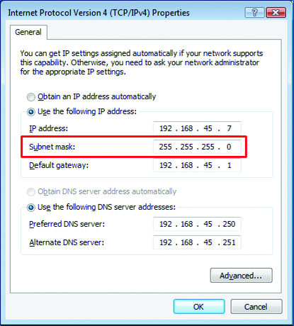
Figure 9.10 A subnet mask of 255.255.255.0 indicates this is a Class C address space.

Slide 117
IP Addresses and Subnetting (continued)
Everything above 224.0.0.0 is reserved for either multicasting or future use.
In addition, certain subnets are reserved for private use and are not routed across public networks such as the Internet:
10.0.0.0 to 10.255.255.255
172.16.0.0 to 172.31.255.255
192.168.0.0 to 192.168.255.255
169.254.0.0 to 169.254.255.255 (Automatic Private IP Addressing)

Slide 118
IP Addresses and Subnetting (continued)
When determining the valid hosts that can be placed on a particular subnet:
The “all 0’s” address of the host portion is reserved for the network address.
The “all 1’s” address of the host portion is reserved for the broadcast address.

Slide 119
IP Addresses and Subnetting (continued)
Again from our earlier example:
Subnet Network Address:
10.10.10.0
00001010.00001010.00001010.00000000
Broadcast Address:
10.10.10.255
00001010.00001010.00001010.11111111
Notes:
In their forwarding tables, routers maintain lists of networks and the accompanying subnet mask. With these two pieces, the router can examine the destination address of each packet and then forward the packet on to the appropriate destination.

Slide 120
IP Addresses and Subnetting (continued)
To divide 192.168.45.0 into multiple networks:
Use a default subnet mask of 255.255.255.0.
You use a 24 bit network ID and 8 bit host ID.
This gives you 254 different host addresses.
If you use a subnet mask of 255.255.255.224:
You “borrow” the first 3 bits from the space you were using to describe host IDs and using them to describe the network ID.
With a 255.255.255.224 subnet mask, you can create six different subnets each with 30 unique host IDs.
Notes:
Remember that the subnet mask tells us how many bits are being used to describe to network ID—adjusting the subnet mask (and the number of bits used to describe the network ID) allows us to divide an address space into multiple, smaller logical networks. Let’s say you have a single address space of 192.168.45.0 that you need to divide into multiple networks.
The default subnet mask is 255.255.255.0, which means you’re using 24 bits as the network ID and 8 bits as the host ID. This gives you 254 different hosts addresses.
But what if you need more networks and don’t need as many host addresses? You can simply adjust your subnet mask to borrow some of the host bits and use them as network bits.
If you use a subnet mask of 255.255.255.224, you are essentially “borrowing” the first 3 bits from the space you were using to describe host IDs and using them to describe the network ID. This gives you more space to create different networks but means that each network will now have fewer available host IDs.
With a 255.255.255.224 subnet mask, you can create six different subnets, but each subnet can only have 30 unique host IDs. If you borrow 6 bits from the host ID portion and use a subnet mask of 255.255.255.252, you can create 62 different networks but each of them can only have two unique host IDs.

Slide 121
Network Address Translation
To compensate for the lack of available IP address space, we use Network Address Translation (NAT).
NAT translates private (nonroutable) IP addresses into public (routable) IP addresses.
A NAT device (typically a firewall or router) translates the many internal IP addresses into one of a small number of public IP addresses.
Notes:
From our discussions earlier in this chapter, you may remember that certain IP address blocks are reserved for “private use,” and you’d probably agree that not every system in an organization needs a direct, Internet-routable IP address. Actually, for security reasons, it’s much better if most of an organization’s systems are hidden from direct Internet access. Most organizations build their internal networks using the private IP address ranges (such as 10.1.1.X) to prevent outsiders from directly accessing those internal networks. However, in many cases those systems still need to be able to reach the Internet. This is accomplished by using a NAT device (typically a firewall or router) that translates the many internal IP addresses into one of a small number of public IP addresses.

Slide 122
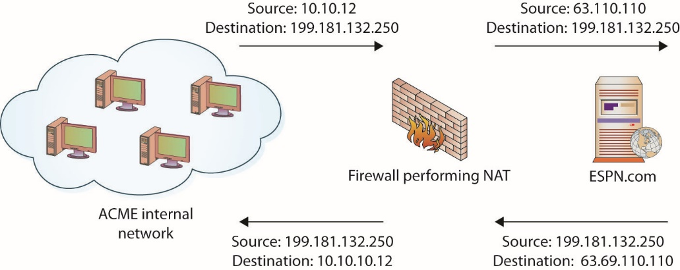
Figure 9.11 Logical depiction of NAT
Notes:
In this figure, we see an example of NAT being performed. An internal workstation (10.10.10.12) wants to visit the ESPN web site at www.espn.com (68.71.212.159). When the packet reaches the NAT device, the device translates the 10.10.10.12 source address to the globally routable 63.69.110.110 address, the IP address of the device’s externally visible interface. When the ESPN web site responds, it responds to the device’s address just as if the NAT device had originally requested the information. The NAT device must then remember which internal workstation requested the information and route the packet to the appropriate destination.

Slide 123
Security Zones
The first aspect of security is a layered defense.
A modern secure network has different layers of protection.
Different zones provide layers of defense.
Trade-offs between access and security are handled through zones.
Between the inner, secure corporate network and the Internet is an area where machines are considered at risk.
This zone has come to be called the DMZ, after its military counterpart, the demilitarized zone, where neither side has any specific controls.
Notes:
Different zones are designed to provide layers of defense, with the outermost layers providing basic protection and the innermost layers providing the highest level of protection. A constant issue is that accessibility tends to be inversely related to level of protection, so it is more difficult to provide complete protection and unfettered access at the same time. Trade-offs between access and security are handled through zones, with successive zones guarded by firewalls enforcing ever-increasingly strict security policies.
Once inside the inner, secure network, separate branches are frequently carved out to provide specific functionality; under this heading, we will also discuss intranets, extranets, flat networks, enclaves, virtual LANs (VLANs), and zones and conduits.

Slide 124
DMZ
A DMZ in a computer network acts as a buffer zone between the Internet, where no controls exist, and the inner, secure network, where an organization has security policies in place.
To demarcate the zones and enforce separation, a firewall is used on each side of the DMZ.
The area between these firewalls is accessible from either the inner, secure network or the Internet.
The firewalls are specifically designed to prevent access across the DMZ directly.
Notes:
Exam Tip: DMZs act as a buffer zone between unprotected areas of a network (the Internet) and protected areas (sensitive company data stores), allowing for the monitoring and regulation of traffic between these two zones.

Slide 125
DMZ (continued)
Only filtered Internet traffic is allowed into the DMZ.
Special attention should be paid to the security settings of network devices placed in the DMZ.
Hardened operating system applies to machines whose functionality is locked down to preserve security.
Unnecessary services and software are removed or disabled, functions are limited, and so on.
Hardening should be applied to the machines in the DMZ.
Notes:
It is important to note that typically only filtered Internet traffic is allowed into the DMZ. For example, an organization hosting a web server and an FTP server in its DMZ may want the public to be able to “see” those services but nothing else. In that case the firewall may allow FTP, HTTP, and HTTPS traffic into the DMZ from the Internet and then filter out everything else.
Special attention should be paid to the security settings of network devices placed in the DMZ, and they should be considered at all times to be at risk for compromise by unauthorized use. A common industry term, hardened operating system, applies to machines whose functionality is locked down to preserve security—unnecessary services and software are removed or disabled, functions are limited, and so on. This approach needs to be applied to the machines in the DMZ, and although it means that their functionality is limited, such precautions ensure that the machines will work properly in a less-secure environment.
Many types of servers belong in this area, including web servers that are serving content to Internet users, as well as remote access servers and external e-mail servers. In general, any server directly accessed from the outside, untrusted Internet zone needs to be in the DMZ. Other servers should not be placed in the DMZ. Domain name servers for your inner, trusted network and database servers that house corporate databases should not be accessible from the outside. Application servers, file servers, print servers—all of the standard servers used in the trusted network—should be behind both firewalls and the routers and switches used to connect these machines. The idea behind the use of the DMZ topology is to provide publicly visible services without allowing untrusted users access to your internal network.

Slide 126
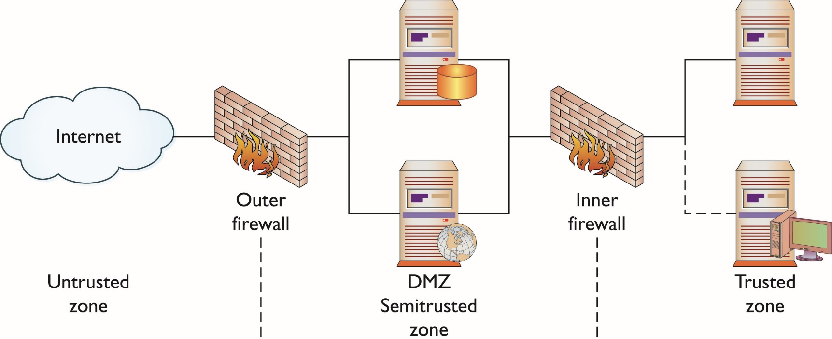
Figure 9.12 The DMZ and zones of trust
Notes:
To demarcate the zones and enforce separation, a firewall is used on each side of the DMZ. The area between these firewalls is accessible from either the inner, secure network or the Internet. The firewalls are specifically designed to prevent access across the DMZ directly, from the Internet to the inner, secure network.
This figure illustrates these zones as caused by firewall placement. The firewalls are specifically designed to prevent access across the DMZ directly, from the Internet to the inner, secure network. It is important to note that typically only filtered Internet traffic is allowed into the DMZ. For example, an organization hosting a web server and an FTP server in its DMZ may want the public to be able to “see” those services but nothing else. In that case the firewall may allow FTP, HTTP, and HTTPS traffic into the DMZ from the Internet and then filter out everything else.

Slide 127
Internet
The Internet is a worldwide connection of networks.
It is used to transport e-mail, files, financial records, remote access—you name it—from one network to another.
It is a series of interconnected networks that allows protocols to operate and enable data to flow across it.
This large web allows users almost infinite ability to communicate between systems.
It should be considered an untrusted network.
The term World Wide Web (WWW) is just one set of services available via the Internet.
Notes:
The Internet is a worldwide connection of networks and is used to transport e-mail, files, financial records, remote access—you name it—from one
network to another. The Internet is not a single network, but a series of interconnected networks that allows protocols to operate and enable data to flow across it. This means that even if your network doesn’t have direct contact with a resource, as long as a neighbor, or a neighbor’s neighbor, and so on, can get there, so can you. This large web allows users almost infinite ability to communicate between systems.
Because everything and everyone can access this interconnected web and it is outside of your control and ability to enforce security policies, the Internet should be considered an untrusted network. A firewall should exist at any connection between your trusted network and the Internet. This is not to imply that the Internet is a bad thing—it is a great resource for all networks and adds significant functionality to our computing environments.
The term World Wide Web (WWW) is frequently used synonymously to represent the Internet, but the WWW is actually just one set of services available via the Internet. WWW or “the Web” is more specifically the Hypertext Transfer Protocol (HTTP)–based services that are made available over the Internet. This can include a variety of actual services and content, including text files, pictures, streaming audio and video, and even viruses and worms.

Slide 128
Intranet
An intranet describes a network that has the same functionality as the Internet for users but lies completely inside the trusted area of a network and is under the security control of the system and network administrators.
Typically referred to as campus or corporate networks
Allows a developer and a user the full set of protocols offered on the Internet, but with the added advantage of trust from the network security
Notes:
Exam Tip: An intranet is a private, internal network that uses common network technologies (such as HTTP, FTP, and so on) to share information and provide resources to organizational users.
Typically referred to as campus or corporate networks, intranets are used every day in companies around the world. An intranet allows a developer and a user the full set of protocols—HTTP, FTP, instant messaging, and so on—that is offered on the Internet, but with the added advantage of trust from the network security. Content on intranet web servers is not available over the Internet to untrusted users. This layer of security offers a significant amount of control and regulation, allowing users to fulfill business functionality while ensuring security.

Slide 129
Intranet (continued)
Two methods can be used to make information available to outside users.
Duplication of information onto machines in the DMZ can make it available to other users.
Extranets can be used to publish material to trusted partners.
Should users inside the intranet require access to information from the Internet, a proxy server can be used to mask the requestor’s location.
Notes:
Two methods can be used to make information available to outside users: Duplication of information onto machines in the DMZ can make it available to other users. Proper security checks and controls should be made prior to duplicating the material to ensure security policies concerning specific data availability are being followed. Alternatively, extranets (discussed in the next section) can be used to publish material to trusted partners.
Should users inside the intranet require access to information from the Internet, a proxy server can be used to mask the requestor’s location. This helps secure the intranet from outside mapping of its actual topology. All Internet requests go to the proxy server. If a request passes filtering requirements, the proxy server, assuming it is also a cache server, looks in its local cache of previously downloaded web pages. If it finds the page in its cache, it returns the page to the requestor without needing to send the request to the Internet. If the page is not in the cache, the proxy server, acting as a client on behalf of the user, uses one of its own IP addresses to request the page from the Internet. When the page is returned, the proxy server relates it to the original request and forwards it on to the user. This masks the user’s IP address from the Internet. Proxy servers can perform several functions for a firm; for example, they can monitor traffic requests, eliminating improper requests such as inappropriate content for work. They can also act as a cache server, cutting down on outside network requests for the same object. Finally, proxy servers protect the identity of internal IP addresses using NAT, although this function can also be accomplished through a router or firewall using NAT as well.

Slide 130
Extranet
An extranet is an extension of a selected portion of a company’s intranet to external partners.
This allows a business to share information with customers, suppliers, partners, and other trusted groups while using a common set of Internet protocols to facilitate operations.
Extranets can use public networks to extend their reach beyond a company’s own internal network, and some form of security (typically VPN) is used to secure this channel.
The use of the term extranet implies both privacy and security.
Notes:
Exam Tip: An extranet is a semiprivate network that uses common network technologies (such as HTTP, FTP, and so on) to share information and provide resources to business partners. Extranets can be accessed by more than one company, because they share information between organizations.
The use of the term extranet implies both privacy and security. Privacy is required for many communications, and security is needed to prevent unauthorized use and events from occurring. Both of these functions can be achieved through the use of technologies described in this chapter and other chapters in this book. Proper firewall management, remote access, encryption, authentication, and secure tunnels across public networks are all methods used to ensure privacy and security for extranets.

Slide 131
Flat Networks
A problem with the spanning tree algorithms is that network traffic is interrupted while the system recalculates and reconfigures.
These disruptions can cause problems in network efficiencies and have led to a push for flat network designs, which avoid packet-looping issues through an architecture that does not have tiers.
One name associated with flat network topologies is network fabric, a term meant to describe a flat, depthless network.
Notes:
As networks have become more complex, with multiple layers of tiers and interconnections, a problem can arise in connectivity. One of the limitations of the Spanning Tree Protocol (STP) is its inability to manage Layer 2 traffic efficiently across highly complex networks. STP was created to prevent loops in Layer 2 networks and has been improved to the current version of Rapid Spanning Tree Protocol (RSTP). RSTP creates a spanning tree within the network of Layer 2 switches, disabling links that are not part of the spanning tree. RSTP, IEEE 802.1w, provides a more rapid convergence to a new spanning tree solution after topology changes are detected. The problem with the spanning tree algorithms is that the network traffic is interrupted while the system recalculates and reconfigures. These disruptions can cause problems in network efficiencies and have led to a push for flat network designs, which avoid packet-looping issues through an architecture that does not have tiers.
One name associated with flat network topologies is network fabric, a term meant to describe a flat, depthless network. These are becoming increasingly popular in data centers, and other areas of high traffic density, as they can offer increased throughput and lower levels of network jitter and other disruptions. While this is good for efficiency of network operations, this “everyone can talk to everyone” idea is problematic with respect to security.

Slide 132
Enclaves
The concept of breaking a network into enclaves can create areas of trust where special protections can be employed and traffic from outside the enclave is limited or properly screened before admission.
Enclaves are not diametrically opposed to the concept of a flat network structure.
Enclaves are carved-out areas, like gated neighborhoods, where one needs special credentials to enter.
A variety of security mechanisms can be employed to create a secure enclave.
Notes:
Modern networks, with their increasingly complex connections, result in systems where navigation can become complex between nodes. Just as a DMZ-based architecture allows for differing levels of trust, the isolation of specific pieces of the network using security rules can provide differing trust environments.
A variety of security mechanisms can be employed to create a secure enclave. Layer 2 addressing (subnetting) can be employed, making direct addressability an issue. Firewalls, routers, and application-level proxies can be employed to screen packets before entry or exit from the enclave. Even the people side of the system can be restricted through the use of a special set of sysadmins to manage the systems.
Enclaves are an important tool in modern secure network design.

Slide 133
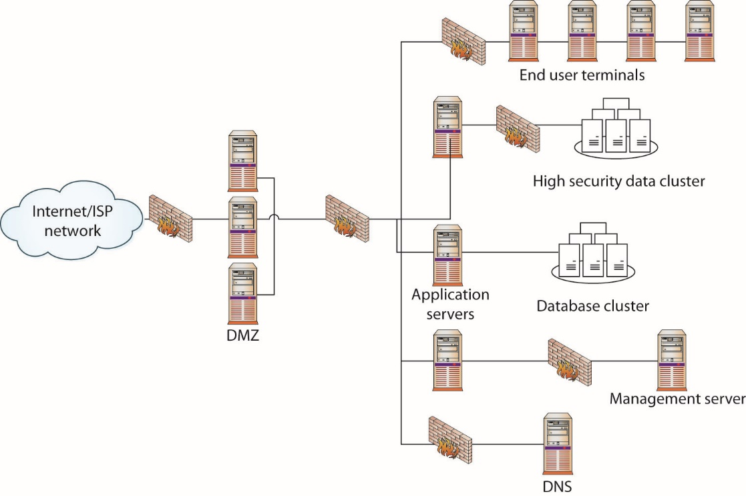
Figure 9.13 Secure enclaves
Notes:
This figure shows a network design with a standard two-firewall implementation of a DMZ. On the internal side of the network, multiple firewalls can be seen, carving off individual security enclaves, zones where the same security rules apply. Common enclaves include those for high-security databases, low-security users (call centers), public-facing kiosks, and the management interfaces to servers and network devices. Having each of these in its own zone provides for more security control. On the management layer, using a nonroutable IP address scheme for all of the interfaces prevents them from being directly accessed from the Internet.

Slide 134
VLANs
A virtual LAN (VLAN) is a logical implementation of a LAN and allows computers connected to different physical networks to act and communicate as if they were on the same physical network.
A VLAN is implemented using switches and software.
VLANS allow significant network flexibility, scalability, and performance.
VLANS allow administrators to perform network reconfigurations without having to physically relocate or recable systems.
Notes:
A LAN is a set of devices with similar functionality and similar communication needs, typically co-located and operated off a single switch. This is the lowest level of a network hierarchy and defines the domain for certain protocols at the data link layer for communication.

Slide 135
VLANs (continued)
Trunking is the process of spanning a single VLAN across multiple switches.
A trunk-based connection between switches allows packets from a single VLAN to travel between switches.
Trunks enable network administrators to set up VLANs across multiple switches with minimal effort.
With a combination of trunks and VLANs, network administrators can subnet a network by user functionality without regard to host location on the network or the need to recable machines.

Slide 136
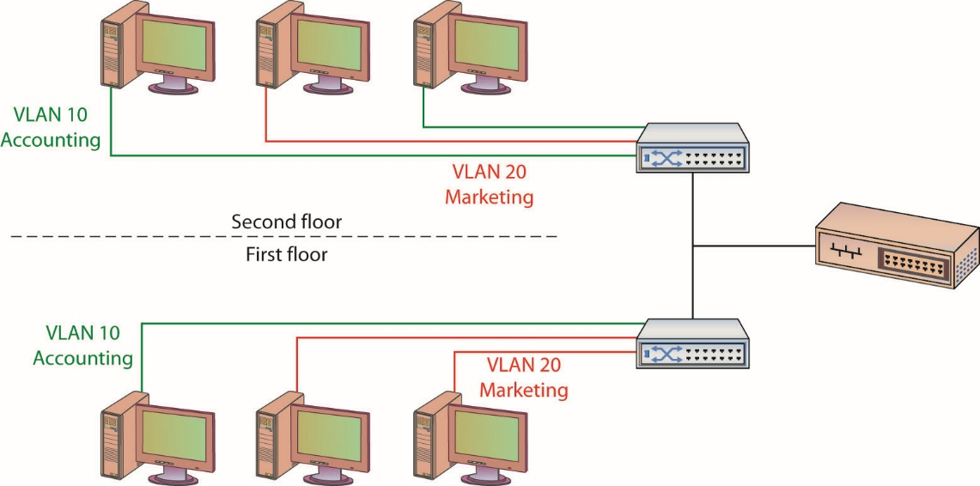
Figure 9.14 VLANs and trunks
Notes:
A trunk-based connection between switches allows packets from a single VLAN to travel between switches, as shown in this figure. Two trunks are shown in the figure: VLAN 10 is implemented with one trunk and VLAN 20 is implemented with the other. Hosts on different VLANs cannot communicate using trunks and thus are switched across the switch network.

Slide 137
VLANs (continued)
Trunks and VLANs have security implications.
VLANs divide a single network into multiple subnets based on functionality.
The physical placement of equipment and cables is logically and programmatically separated so that adjacent ports on a switch can reference separate subnets.
Prevents unauthorized use of physically close devices through separate subnets on the same equipment.
Both a purpose and a security strength of VLANs is that systems on separate VLANs cannot directly communicate with each other.
Notes:
VLANs are used to divide a single network into multiple subnets based on functionality. This permits accounting and marketing, for example, to share a switch because of proximity yet still have separate traffic domains.
VLANs also allow a network administrator to define a VLAN that has no users and map all of the unused ports to this VLAN (some managed switches allow administrators to simply disable unused ports as well). Then, if an unauthorized user should gain access to the equipment, that user will be unable to use unused ports, as those ports will be securely defined to nothing.

Slide 138
Zones and Conduits
A zone is a grouping of elements that share common security requirements.
Zones have a defined set of common security requirements that differ from outside the zone.
A conduit is defined as the path for the flow of data between zones.
Data flows in or out of a zone are defined by a conduit.
The conduit allows a means to focus the security function on the data flows, ensuring the appropriate conditions are met before data enters or leaves a zone.
Notes:
The terms zones and conduits have specialized meaning in control system networks. Control systems are the computers used to control physical processes, ranging from traffic lights to refineries, manufacturing plants, critical infrastructure, and more. These networks are now being attached to enterprise networks and this will result in the inclusion of control system network terminology into IT/network/security operations terminology. A term commonly used in control system networks is zone.
Zones are similar to enclaves in that they have a defined set of common security requirements that differ from outside the zone. The zone is marked on a diagram, indicating the boundary between what is in and outside the zone. All data flows in or out of a zone must be by a defined conduit. The conduit allows a means to focus the security function on the data flows, ensuring the appropriate conditions are met before data enters or leaves a zone.

Slide 139
Tunneling
Tunneling is a method of packaging packets so that they can traverse a network in a secure, confidential manner.
It involves encapsulating packets within packets, enabling dissimilar protocols to coexist in a single communication stream, as in IP traffic routed over an Asynchronous Transfer Mode (ATM) network.
It can provide significant measures of security and confidentiality through encryption and encapsulation methods.
Notes:
Assume, for example, that a company has multiple locations and decides to use the public Internet to connect the networks at these locations. To make these connections secure from outside unauthorized use, the company can employ a VPN connection between the different networks. On each network, an edge device, usually a router or VPN concentrator, connects to another edge device on the other network. Then, using Ipsec protocols, these routers establish a secure, encrypted path between them. This securely encrypted set of packets cannot be read by outside routers; only the addresses of the edge routers are visible. This arrangement acts as a tunnel across the public Internet and establishes a private connection, secure from outside snooping or use.
Note: A VPN concentrator is a specialized piece of hardware designed to handle the encryption and decryption required for remote, secure access to an organization’s network.
Because of ease of use, low-cost hardware, and strong security, tunnels and the Internet are a combination that will see more use in the future. IPsec, VPN, and tunnels will become a major set of tools for users requiring secure network connections across public segments of networks.

Slide 140
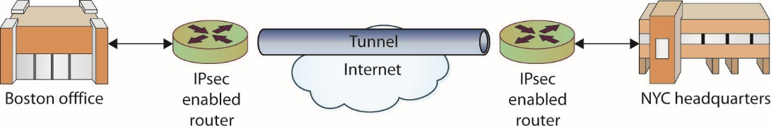
Figure 9.15 Tunneling across a public network
Notes:
The best example of significant measures of security and confidentiality through encryption and encapsulation methods is a VPN that is established over a public network through the use of a tunnel, connecting a firm’s Boston office to its New York City (NYC) office.

Slide 141
Storage Area Networks
Storage area networks (SANs) are systems which provide remote storage of data across a network connection.
The design of SAN protocols:
Makes the disk appear to actually be on the client machine as a local drive rather than as attached storage, as in network attached storage (NAS)
Makes the disk visible in disk and volume management utilities and allows their functionality
Common SAN protocols are iSCSI and Fibre Channel.

Slide 142
iSCSI
The Internet Small Computer System Interface (iSCSI) is a protocol for IP-based storage.
iSCSI can be used to send data over existing network infrastructures, enabling SANs.
Positioned as a low-cost alternative to Fibre Channel storage, the only real limitation is one of network bandwidth.

Slide 143
Fibre Channel
Fibre Channel (FC) is a high-speed network technology (with throughput up to 16 Gbps) used to connect storage to computer systems.
The FC protocol is a transport protocol similar to the TCP protocol in IP networks.
Carried via special cables, one of the drawbacks of FC-based storage is cost.

Slide 144
FCoE
The Fibre Channel over Ethernet (FCoE) protocol encapsulates the FC frames, enabling FC communication over 10-Gigabit Ethernet networks.

